Slide 1
The Cofunded Partnerships in Horizon Europe: an overview and Masaf participation
Annual Conference ERIAFF
Plenary Session Reinforcing interregional collaboration: opportunities from the European Union
Bolzano – 23 Maggio 2023
Serenella puliga
Ufficio DISR 4 – Ricerca e sperimentazione - Direzione generale delle sviluppo rurale
Ministero dell’agricoltura, della sovranità alimentare e delle foreste
Ministry of Agriculture, Food Sovereignty and Forestry – MasaF - ItalY

Slide 2
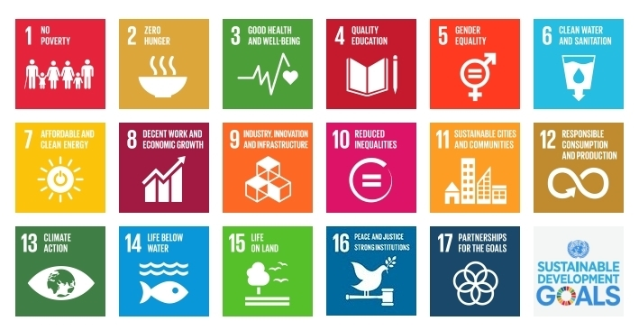
EU strategies toward 2021-2027
The future of food and farming 2017
Green Deal 2018
Farm to fork 2020
EIP - AGRI: Agricultural Productivity and Sustainability
COM(2017)713
COM/2012/79
COM(2019)640
COM(2020)381
Long term vision for rural areas
FOREST
COM/2021/572
SOIL STRATEGY
COM(2021) 345
COM/2021/699
Organic Plan
COM/2021/141

Slide 3
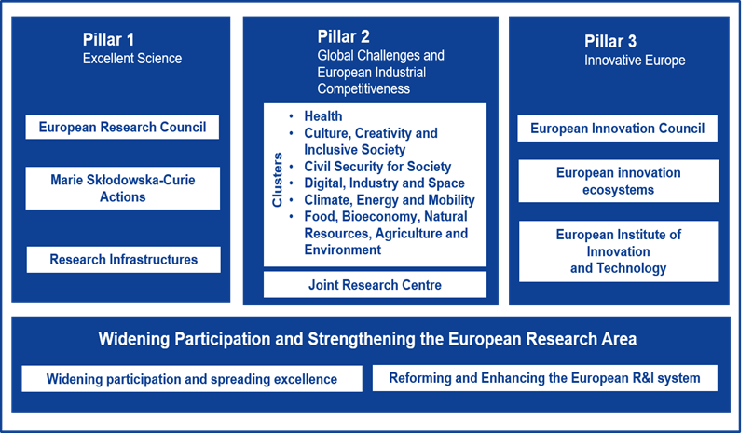
research and innovation
HORIZON EUROPE 2021-2027
cluster 6
€ 10 billions

Slide 4
What are European Partnerships?
Initiatives in which the European Union (EU), national authorities and/or the private sector jointly undertake to support the development and implementation of a research and innovation activity programme.
Who are the partners?
Public authorities at local, regional, national or international level, universities, research organisations, companies, civil society organisations, including foundations and NGOs
How partnerships can drive the green and digital transition?
addressing the complex challenges outlined in Horizon Europe, such as accelerating transitions towards a climate-neutral and circular society and economy;
supporting the realisation of EU priorities such as the European Green Deal, Digital Europe, the economy serving citizens and a stronger Europe in the world;
being impact-oriented and to this end will carry out a wide range of R&I activities, from design, demonstration and testing to market, regulatory and societal deployment;
contributing to strengthening the European Research Area (ERA) by avoiding duplication of efforts, creating critical levels of investment and enhancing synergies between programmes.

Slide 5
PARTNERSHIPS - COFUND
Agro-ecology living labs
Animal health
Agriculture of Data
Safe and Sustainable Food System
Biodiversity to safeguard life on Earth
Blue Oceans and Blue economy
Water4All - Water security for the planet
Circular bio-based Europe
Based on a common strategy for research and innovation (SRIA) all the players in aggregate forms likely to result in real living labs (e.g. Agroecology, Food system etc.)
common objectives, indicators, outputs
new forms of collaboration for R&I governance
among research funding institutions (mainly public) in the European Room Area (ERA)
Cluster 6
8 partnerships out of the 38 programmed in Pillar 2 top interest for the primary sector

Slide 6
WP
2023/2024
38 partnership in Pillar II
Under evaluation
8 partnership in Cluster 6
7 out of 8 cofunded

Slide 7
Partnerships setting up
(WP 2023-2024)
2021-2022 preparatory phase
December 2022: HORIZON EUROPE WP 2023/2024 (calls)
Different process for each partnership: in some cases key role of Working Group (SWG/CWG) in SCAR, in other specific support action like CSA (e.g. FOODPaths, AE4EU, ALL-Ready, EUFORE, FORESTVALUE2)
Wide and complex debate
Working group with EU officers, (DG Research, DG AGRI), member of Eranet/JPI ecc, related to the partnership themes, other stakeholders

Slide 8
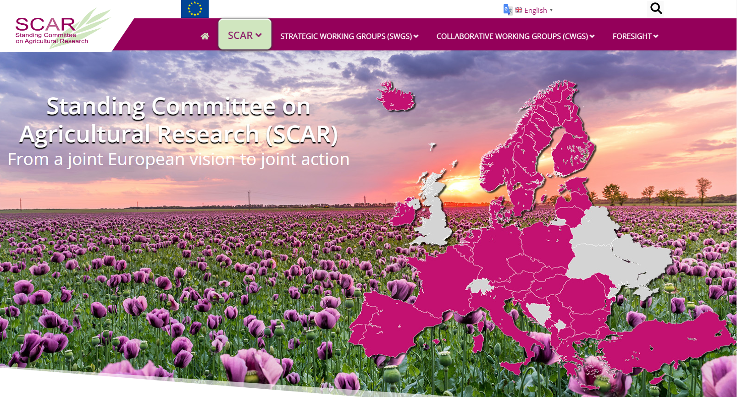
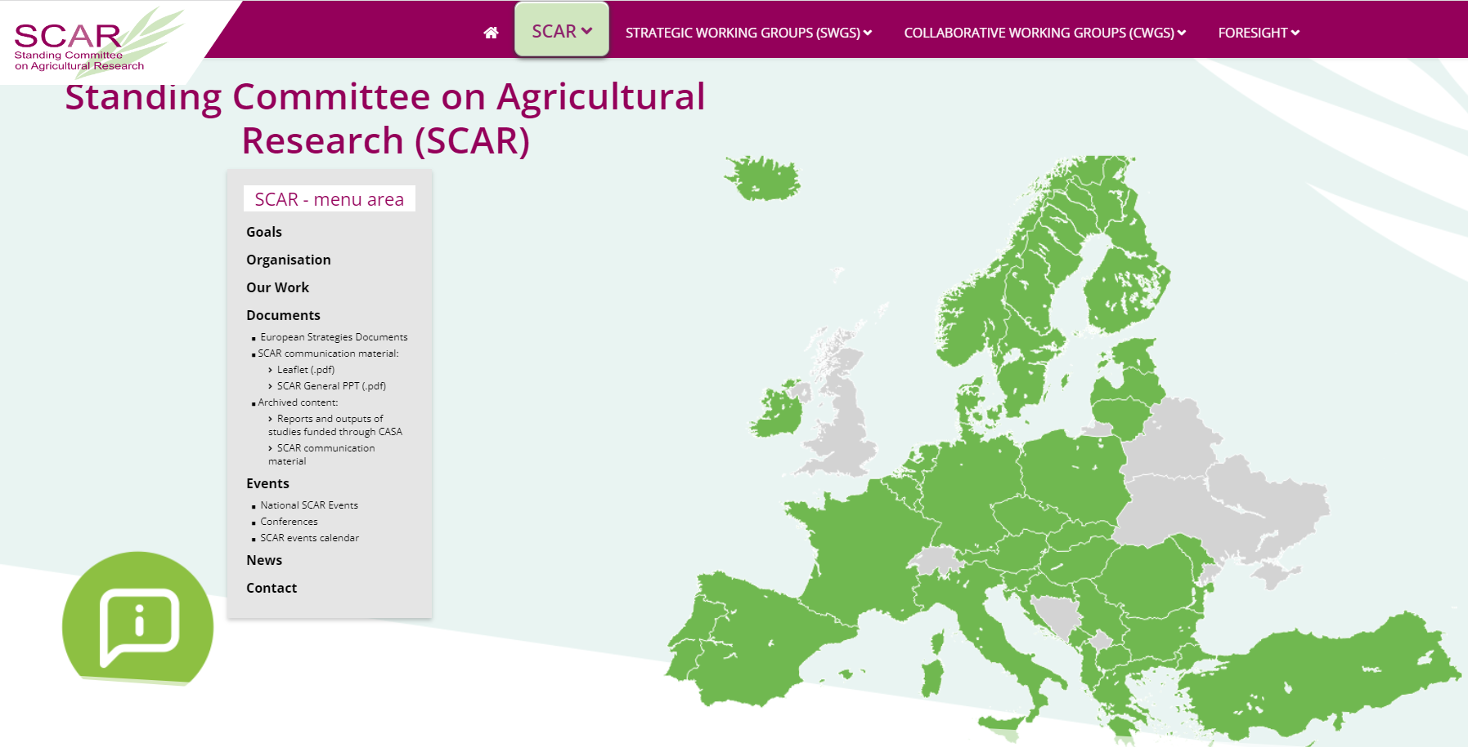
Vision
The Green Deal has put Europe in a favourable position to be a groundbreaker in the transition to sustainable agriculture, forestry, and food systems. European research and innovation (R&I) in these areas play a key role in accelerating the European Green Deal agenda.
SCAR advises the European Commission (EC), EU Member States and Associated Countries on R&I priorities to address Europe’s challenges in agriculture, fisheries, food systems, forestry, and the wider bioeconomy. SCAR co-creates impactful R&I strategies, working closely with the European Commission.
SCAR inspires R&I through foresight studies and by providing recommendations.
SCAR strengthens the European Research Area. It is a key platform for co-creating five Horizon Europe Partnerships: ambitious instruments that align EU and national R&I agendas to achieve actionable results in key Green Deal priority areas.

Slide 9
SCAR FOREST

Slide 10
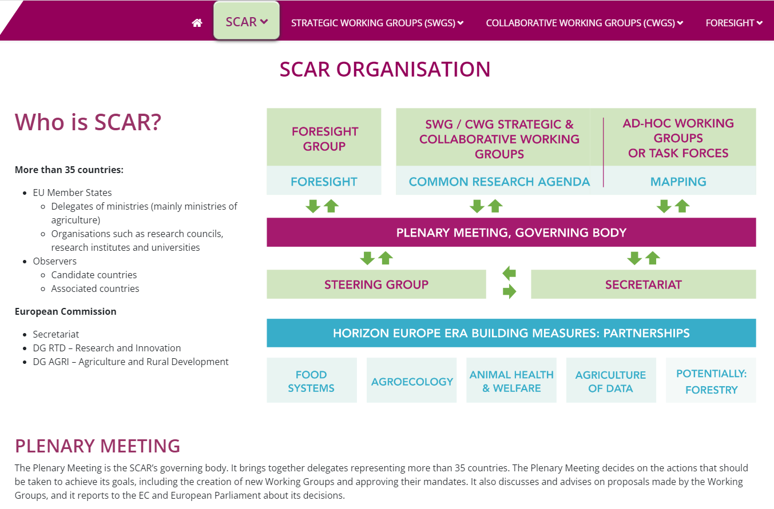

Slide 11
Partnerships – main traits
Based on commonly agreed strategic areas (Strategic Research Innovation Agenda - SRIA) – (updating foreseen also during the partnerships lifetime)
Multiactor approach of knowledge system in agriculture (AKIS)
Various actions:
Joint calls
Promotion and support for Living Labs and research infrastructures
Setting up of knowledge hubs and tools
Sinergies with other programmes and initiatives (Partnerships, Missions, PAC, FESR, LIFE, Operational Groups EIP-AGRI etc…)
Communication, dissemination, exploitation of outcomes and results
Others..
duration 7-10 years
Grant Agreement 2-years

Slide 12
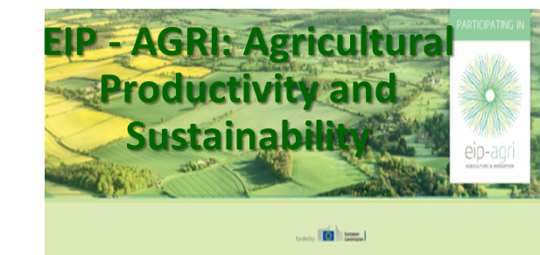
EIP AGRI multi-actorial approach
Digitalization (Investments by EU Funds – FEASR, FESR ecc.)
Research and innovation (Horizon Europe)
Knowledge must be affordable for farmers, key role of advisory system
CAP National Strategic Plan following the EU strategies goals
actions for sustainable practices: precision farming, organic farming, agroecological approach, animal welfare, sustainable use of plant protection products, optimal use of nutrients..

Slide 13
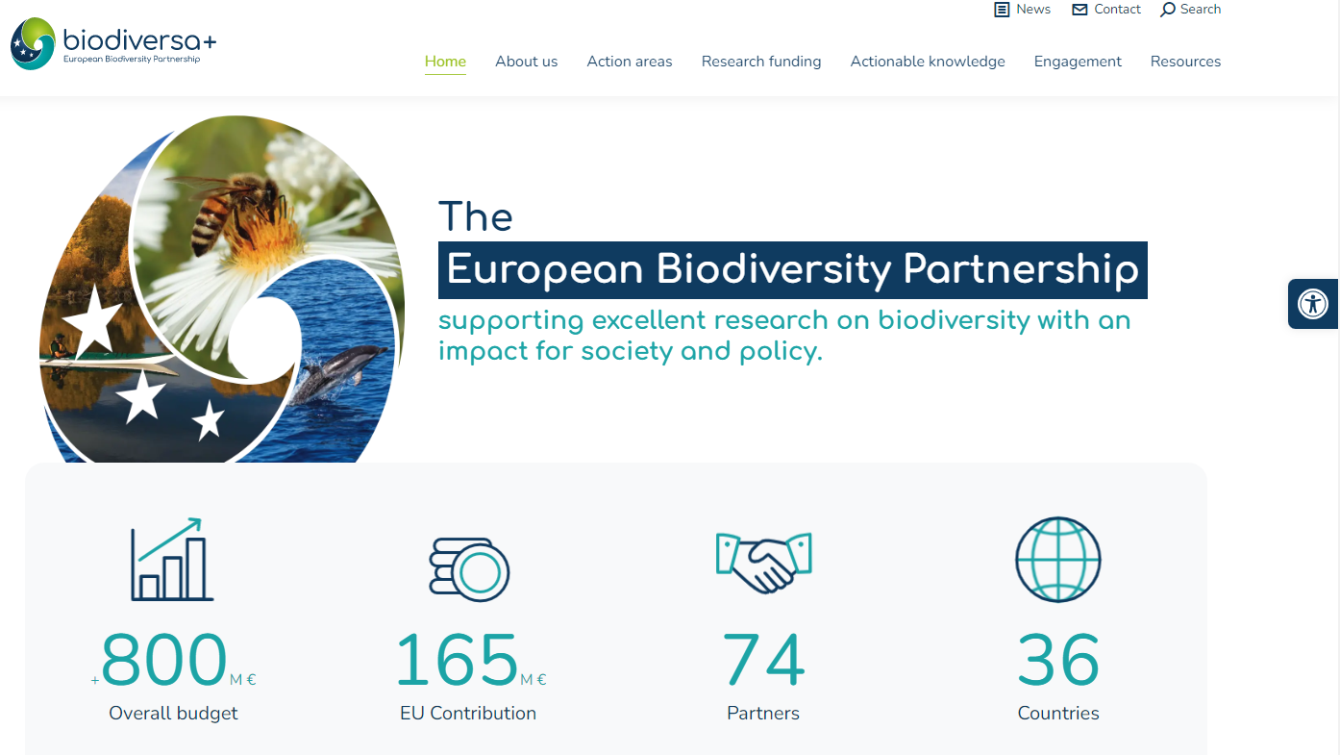
https://bluepartnership.eu/
January 2023
Coordination
MUR (Italy) and RCN (Norway)
https://www.water4all-partnership.eu/
1° June 2022
Coordination
ANR (France)
1° October 2021
https://www.biodiversa.eu/
Coordination
BSPO (Belgium)
FORMAS (Sweden)
DLR-PT (Germany)

Slide 14
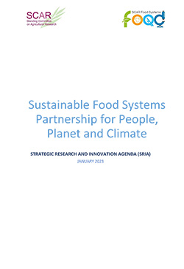
Vision to achieve collectively environmentally-friendly, socially secure and fair, economically viable, healthy and safe food systems in Europe in order to realise the Farm to Fork strategy goals, in line with the global ambitions of United Nations (UN) Sustainable Food Summit 2021.
Mission to mobilize Research and Innovation (R&I) to accelerate the transition towards Sustainable Food Systems with a wide range of actors joining forces.
Objectives
Understand what SFS are, how they function and how to enable their development
Co-create with various actors in a diversity of Living Labs to develop SFS concepts and definitions
Demonstrate that a ‘systemic approach’ functions as a catalyst to transform FS into SFS, during but also beyond the lifetime of the Partnership
Ensure that the well-governed Partnership contributes to SFS via frameworks and evidence-supporting policy options for EC objectives (F2F, missions, Green Deal and UN-SDG)
Thematic areas
Change the way we eat
Change the way we process and supply food
Change the way we connect (citizens) with food systems
Change the way we govern the food systems
Activities
Joint funding of R&I for food systems transformation/ Pooling R&I resources and programming
Launching a food systems observatory
Establishing a food systems knowledge hub – Learning from initiatives in the SFSS and the knowledge hub
Knowledge sharing and scaling, adapting knowledge systems, innovations platforms and science policy interfaces; competence building/education, including scientific advice for policymaking

Slide 15
Partnership Agroecology

Slide 16
AGRICULTURE NEEDS
Partnership AGRIDATA

Slide 17
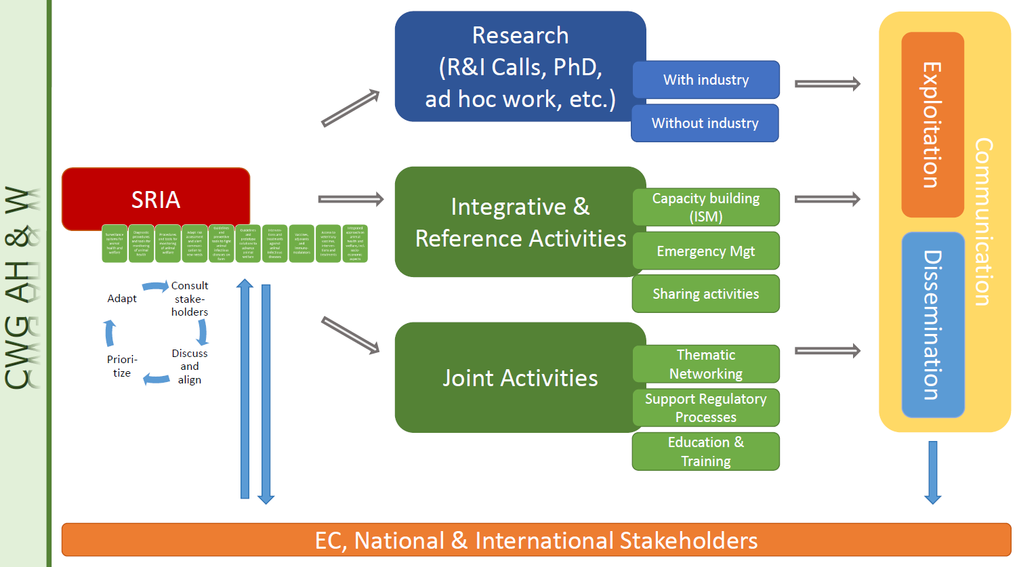
Partnership Animal Health and Welfare
tools for the monitoring and control of infectious diseases in livestock, with prudent use of antimicrobials and with respect of animal welfare thus contributing to sustainable livestock farming and the protection of public health and the environment.
strengthened cooperation between public research and innovation entities, and the association of relevant partners, including the animal health industry, animal welfare entities and other stakeholders.
to build a strong research and innovation framework strengthening Europe’s capacity to raise healthy animals and to improve welfare standards.

Slide 18
Partnership FORESTRY
EXPECTED IN WP 2025-2026
Notes:
Silvia

Slide 19
AGRICULTURE OF DATA
BIODIVERSITY
ANIMAL HEALTH AND WELFARE
ECOLOGICAL SUSTAINABLE TRANSITION
FORESTRY
AGROECOLOGY
WATER4ALL
SUSTAINABLE
FOOD SYSTEMS
BLUE ECONOMY

Slide 20
Thank you
s.puliga@masaf.gov.it
https://www.politicheagricole.it/flex/cm/pages/ServeBLOB.php/L/IT/IDPagina/9064

