Slide 1

Eu–partnerships: a region´s perspective
AUTONOME PROVINZ BOZEN - SÜDTIROL
PROVINCIA AUTONOMA DI BOLZANO - ALTO ADIGE
Abteilung 34 – Innovation Forschung Universität und Museen
Ripartizione 34 – Innovazione Ricerca Università e Musei
Amt für Wissenschaft und Forschung
Ufficio Ricerca scientifica
05/23/2023 Laura Cherchi

Slide 2
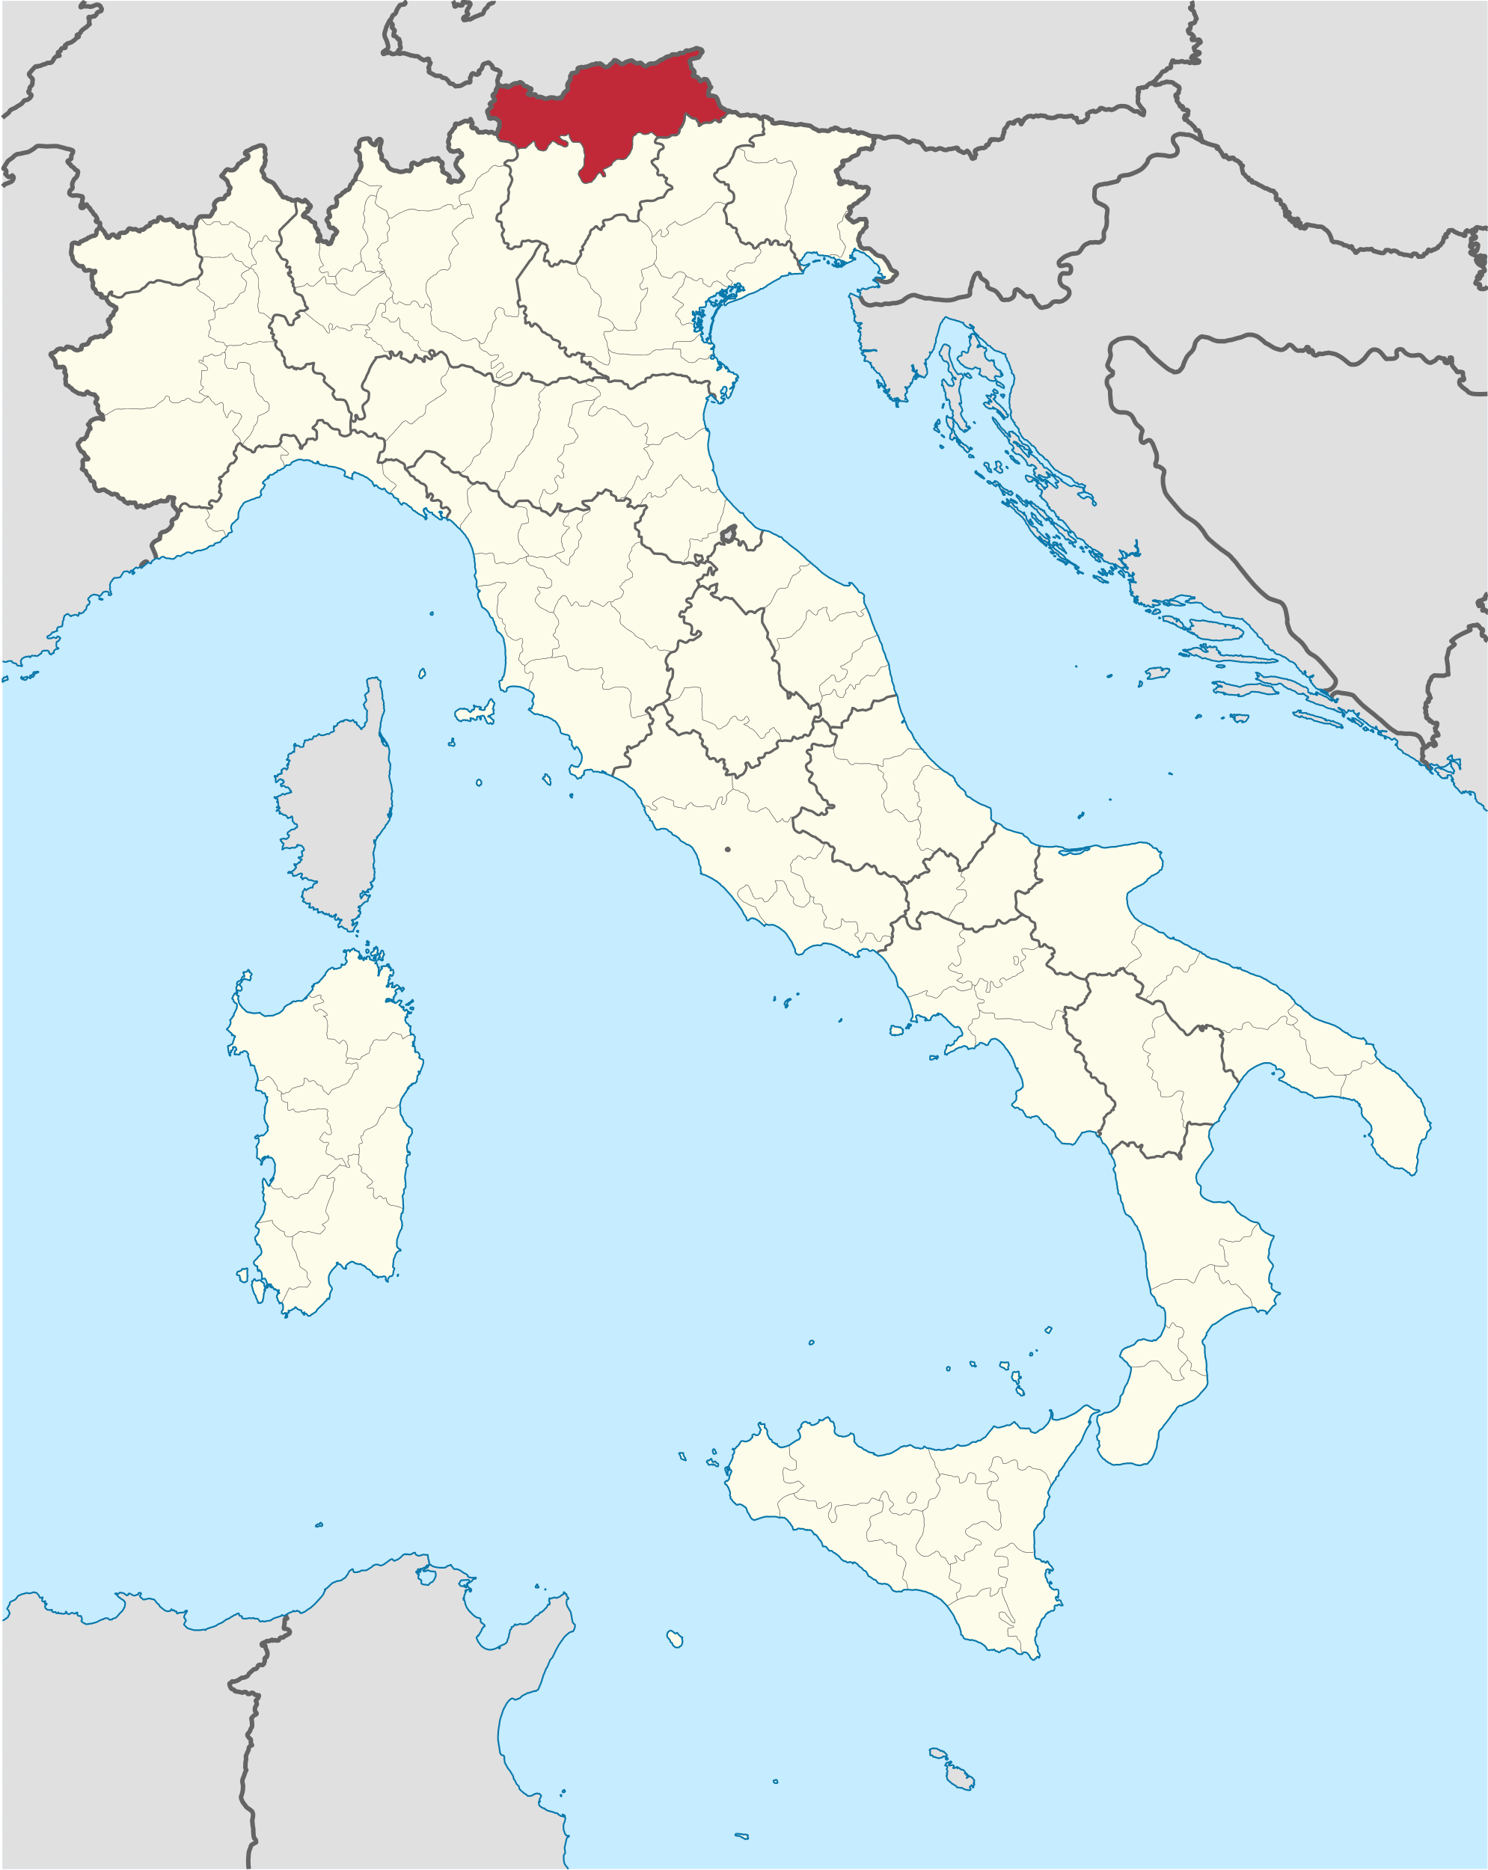
South Tyrol
We are a small region with high potential
Mostly known as touristic destination
than for ist performance in research
and innovation

Slide 3
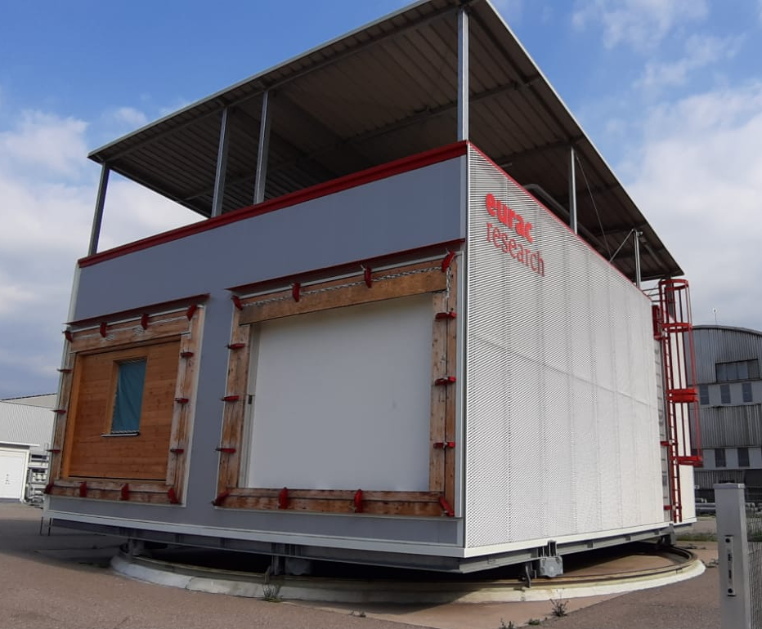
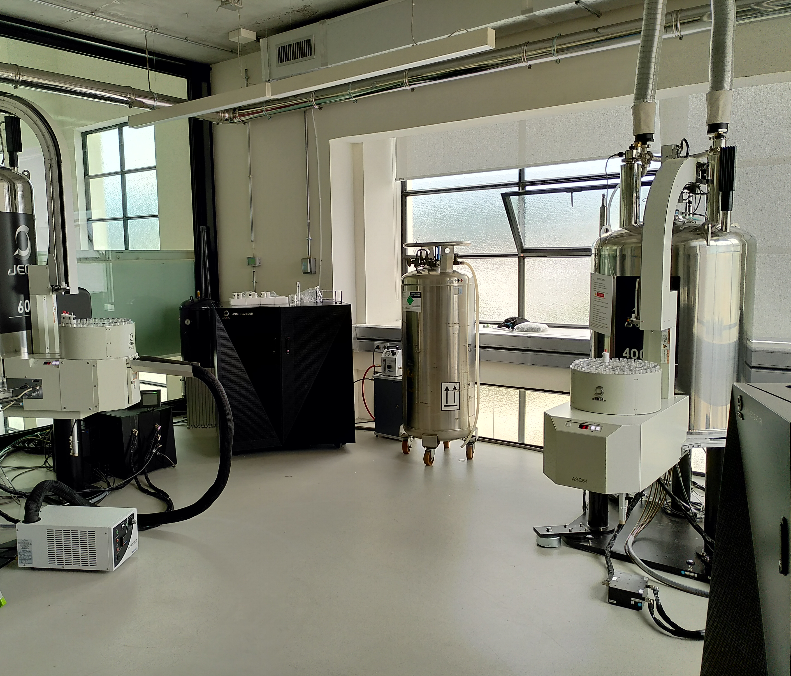
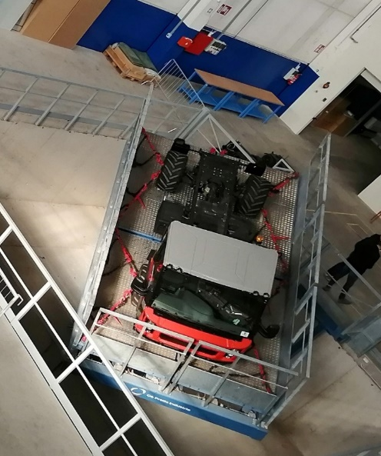

Capacity building 14-21: Laboratories
Green and Energy
https://noi.bz.it/it
Alpine technologies
Food technologies
Environmental technologies

Slide 4
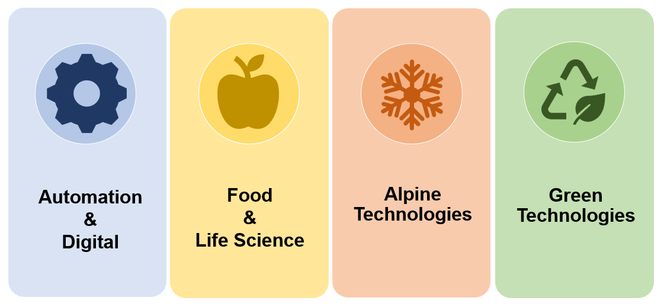
RIS3 Strategy – Specialization fields

Slide 5
Our funding strategy for research
Since 2019 we have started a new strategy for scientific research and internationalisation including a varied range of measures
Call for interregional projects
Calls for joint bilateral projects AT, DE, Lux, CH
Call for int. Mobility of researchers
MSCA Seal of excellence
Grant Open Access pubs
www.provincia.bz.it/innovazione-ricerca/innovazione-ricerca-universita/

Slide 6

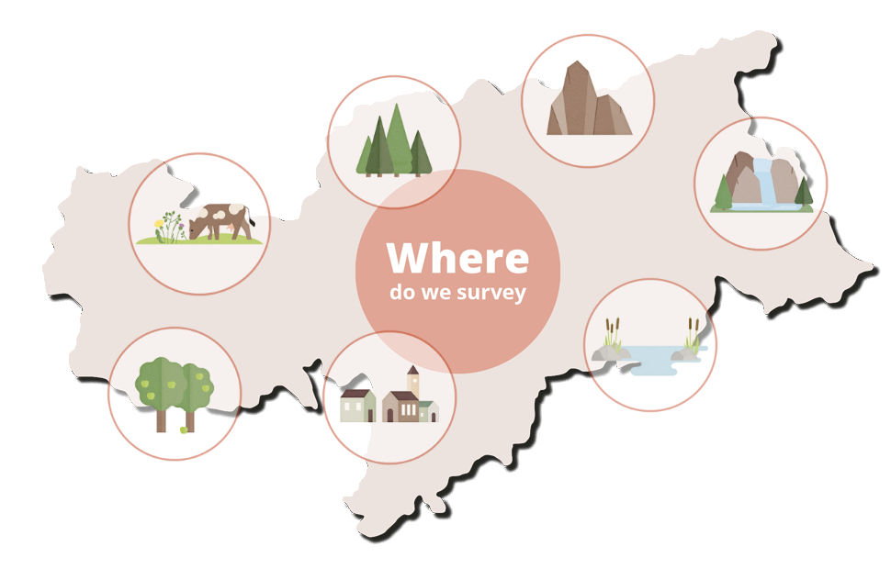
Monitoring biodiversity in
South Tyrol
Starting from 2019 a permanent monitoring of biodiversity in South Tyrol is set up.
Eurac research coordinates it in cooperation with the Science Museum of South Tyrol and the Autonomous Province of Bolzano.
https://biodiversity.eurac.edu/

Slide 7
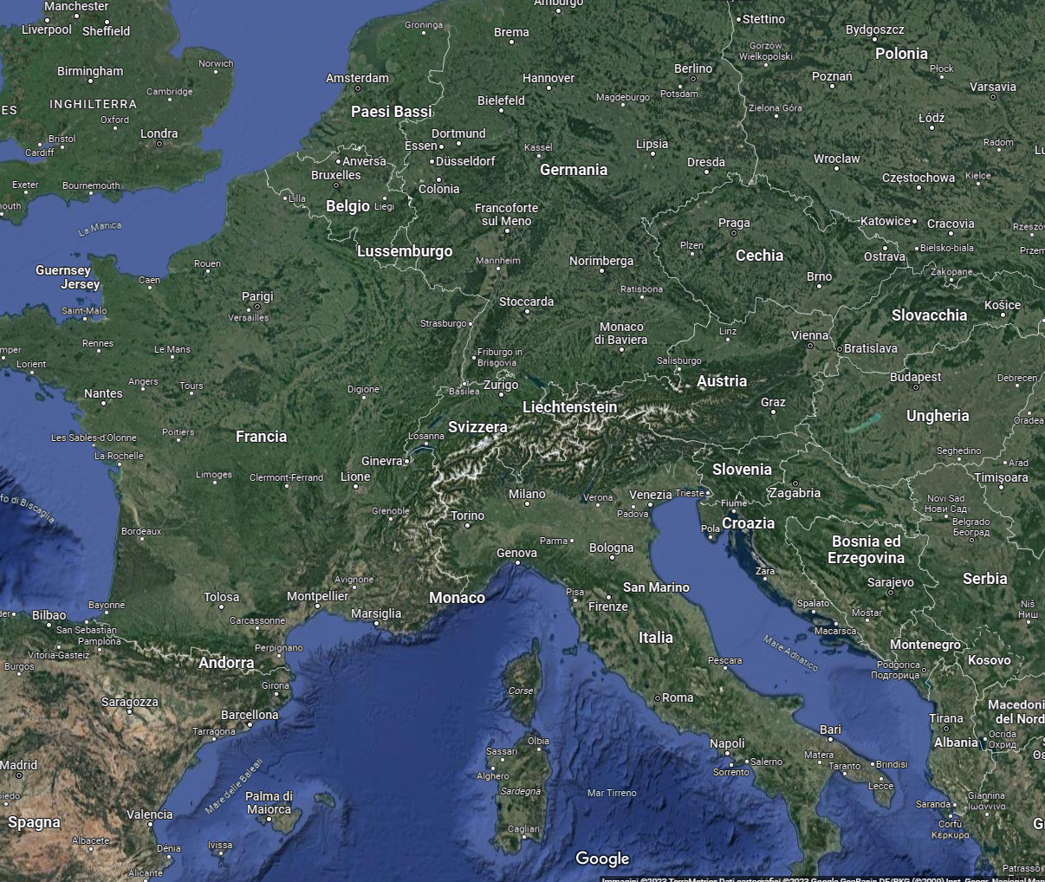

Scaling –up our strategy at EU level

Slide 8


“European Biodiversity Partnership supporting excellent research on biodiversity with an impact for society and policy.”
Status: started Oct 2021
2 launched calls for proposals +
1 to be announced very soon
1 pilot project on biodiversity monitoring
    https://www.biodiversa.eu/
The Autonomous Province of Bolzano:
funds with 1,5 millions euros + 23% EU top-up
co-leads and costs covered by EU
+ know-how and visibility at international level

Slide 9
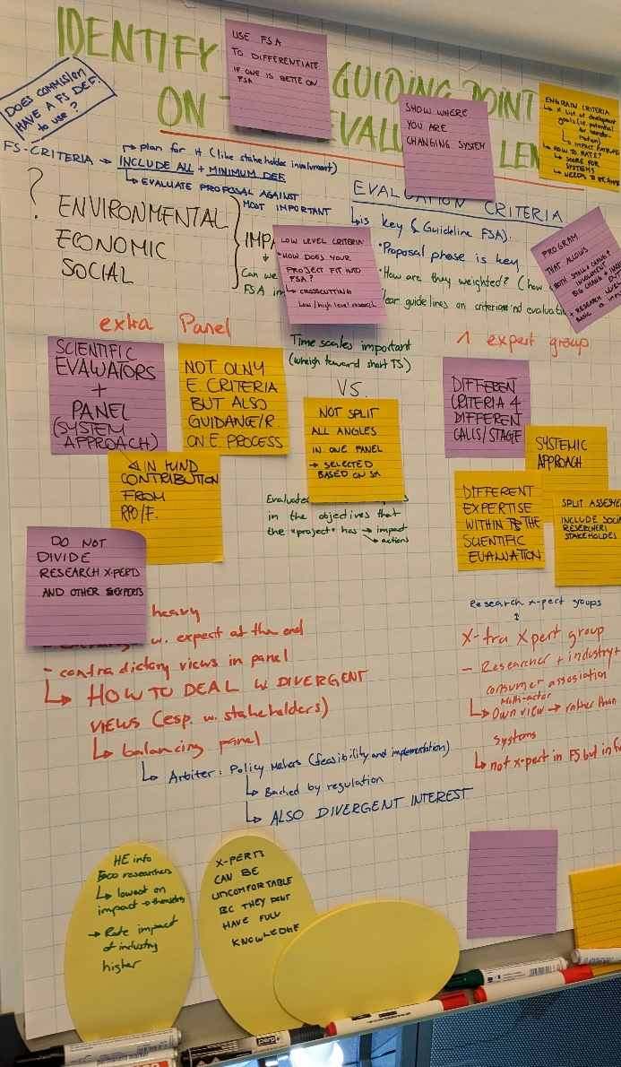
Eu- partnerships
Agroecology
Accelerating farming systems transitions: agroecology living labs and research infratructures
Status: expected to start in 2024
Our role: Co-funding member and WP Monitoring co-leader
FutureFoodS
Sustainable food systems for people, planet and climate
Status: expected to start in 2024
Our role: Co-funding member

Slide 10

PROs
Scaling up our funding strategy for research
Return on investment: EU co-funds members´investements in R&I projects and activities (between 20-30%) = more projects and more activities
Taking active part in the process
Building capacity both for public administration and for the involved research institutions
International networking and visibility
Synergies at national and at local level

Slide 11
AUTONOME PROVINZ BOZEN - SÜDTIROL
PROVINCIA AUTONOMA DI BOLZANO - ALTO ADIGE
Abteilung 34 - Innovation Forschung Universität und Museen
Ripartizione 34 – Innovazione Ricerca Università e Musei
Amt für Wissenschaft und Forschung
Ufficio Ricerca scientifica
Thank you for your attention
Laura Cherchi
Autonomous Province of Bolzano/Bozen South Tyrol
Laura.cherchi@provincia.bz.it

