Slide 1
The European Partnerships : opportunities and challenges for the regions
Pays de la Loire: European Partnership “Accelerating Farming Systems Transition: Agroecology Living Labs and Research Infrastructures”

Slide 2
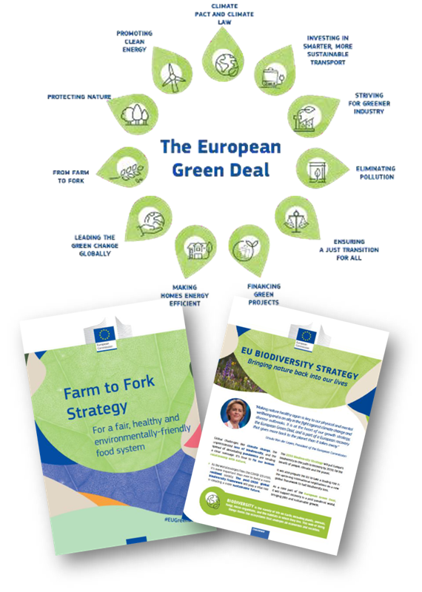
Context
Agroecology and Livings Labs partnership
Vision : Unlock the transition to agroecology
Contribution to the European Green Deal (Farm to Fork Strategy, EU Biodiversity Strategy)
Agroecology: transition to resilient agriculture and food systems - Paradigm change
Reponse to challenges faced by European agriculture (climate change, biodiversity loss, food security and sovereignty, pollution)
Network of Living Labs and Research Infrastructures
Long-term, place-based, multi-actor, real-life implementation of agroecology research across Europe

Slide 3
Context
Regional context
Regional priorities
Agriculture + food industry : key economic sectors
Regional strategy 2023-2028 « land and sea - let’s act for sustainable food »
Transformation of agriculture and food systems
Reinforcement of support to innovation, engagement for European cooperation
Positive momentum
Experience of participation in European projects (project H2020 SmartAgriHubs; HE Clean Energy Transition Partnership)
Ecosystem
Project team : Regional council + Brussels office
Involvement of local stakeholders key drivers (Chamber of Agriculture and Competitiveness cluster Végépolys Valley)

Slide 4
Opportunities
Complementary role of the region as a funding partner
Funding of regional actors and economic stakeholders/downstream
Participation in the activities of the partnership
Factor in the needs of the regional ecosystem
Drafting of the SRIA and AWPs
Impact
For the region
Go beyond regional actions towards agroecology
Integration of the region in European networks / visibility
Co-fund : lever effect
Expected benefits for the regional ecosystem
For the partnership
Inclusion of different levels of gouvernance (regional and local authorities) broader range of stakeholders
Implementation of the Living Labs approach and delivery on the goals of the partnership

Slide 5
Challenges
Taking ownership of the partnership
Capability
Information/framing
Emerging tool
Clarifications and fine-tuning
National coordination
But also….opportunity
Regional coordination
But also… opportunity
Next steps
Next challenge: Implementation
Q3 2023 – Evaluation and interaction with the EC
Q4 2023 – Preparation of the Grant Agreement
2024 – Start of the partnership
1st AWP
….

Slide 6
Conclusion
Importance of the context : momentum and timing
Mobilisation of the ecosystem
Added-value of the participation of regions
Participation in the Agroecology and Living Labs still possible
Participation in other partnerships under consideration

Slide 7
The European Partnerships : opportunities and challenges for the regions
Pays de la Loire: European Partnership “Accelerating Farming Systems Transition: Agroecology Living Labs and Research Infrastructures”
Thank you for your attention!
Contact: Bénédicte Blaudeau, Policy Officer, Pays de la Loire EU Office
benedicte.blaudeau@paysdelaloire.eu

