Slide 1

FOODPathS
With Regions co-creating the 'Sustainable FOOD Systems (SFS) PArTnersHip'
23/5/2023 – ERIAFF Annual Conference, Bolzano’
Hugo de Vries, Project coordinator FOODPathS

Slide 2
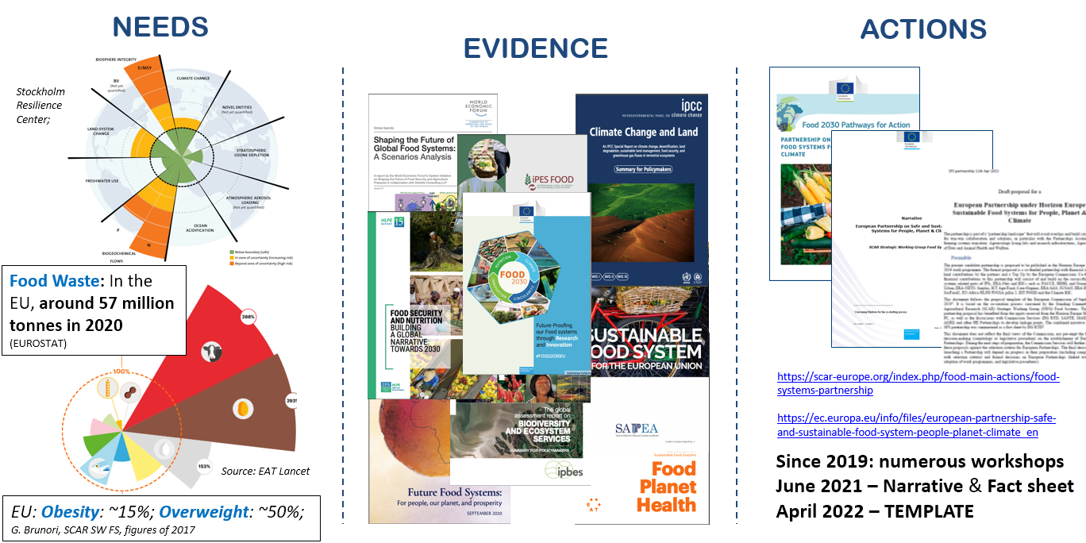
Why is there a need joining forces to reach sustainable food systems?
SRIA, page 6 & 12

Slide 3
What is the Partnership SFS about?
VISION:
its actors collectively will achieve environmentally-friendly, socially secure and fair, economically viable, healthy and safe food systems in Europe in order to help realise its goals of the Farm to Fork strategy, in line with the global ambitions of United Nations (UN) Sustainable Food Summit 2021.
MISSION:
to mobilize Research and Innovation (R&I) to accelerate the transition towards SFS with a wide range of actors in P-SFS.

Slide 4
What? > The Focus areas of the future P-SFS (from a food systems lens; post farming & fishing oriented)
Vertical
Horizontal
TF1 – Change the way (what) we eat
TF5 – Co-funding and Programming
TF2 – Change the way we process and supply
TF6 – FS observatory, data, methods
TF7 – FS knowledge hub of FS Labs
TF3 – Change the way we connect (act) citizens and food production
TF8 – Knowledge sharing and scaling
TF4 – Change the way we govern the food systems
https://scar-europe.org/images/FOOD/Main_actions/SFS_Partnership_SRIA_31012023.pdf

Slide 5
How? CSA Project 'Co-creating the Prototype Sustainable FOOD Systems PArTnersHip'
European Project no. 101059497
Call topic: ‘HORIZON-CL6-2021-GOVERNANCE-01-03 ‘Preparatory action for the HE Food Systems Partnership’.
Duration: 3.5 year
  kick-off: 1/6/2022;
  foreseen: 2 years overlap with future partnership
17 partners representing 19 networks
(local, regional, national, European, global, public-private, philanthropic, research, education, innovation, communication, management)
Budget: 4.9 M€
In 2024: the BIG Partnership (> XXX M€)

Slide 6

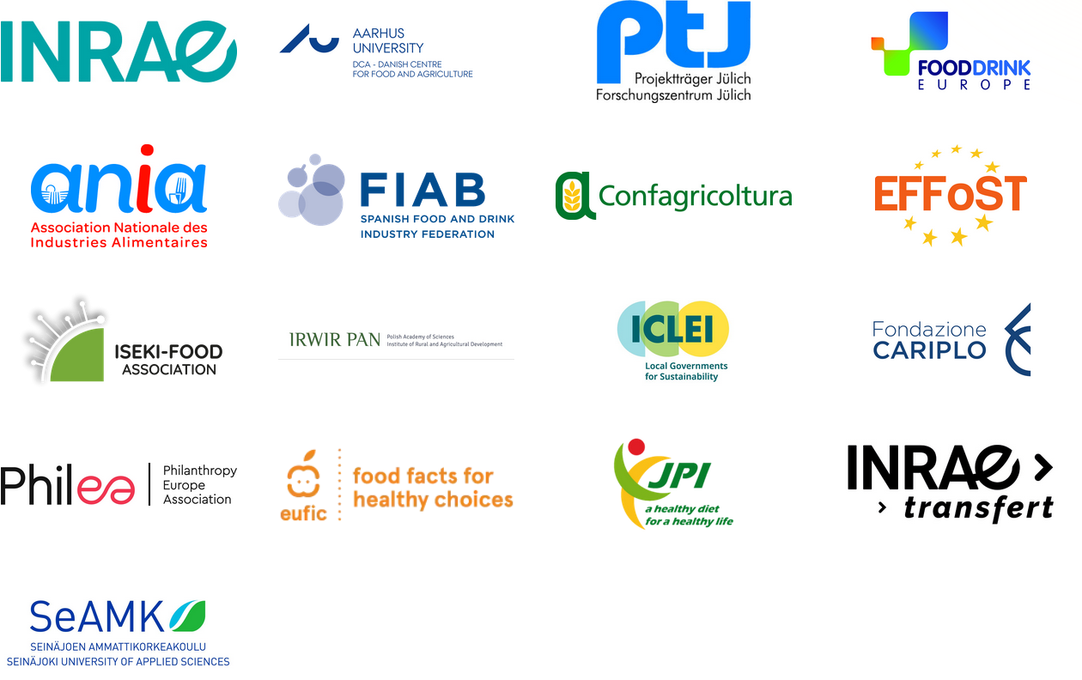
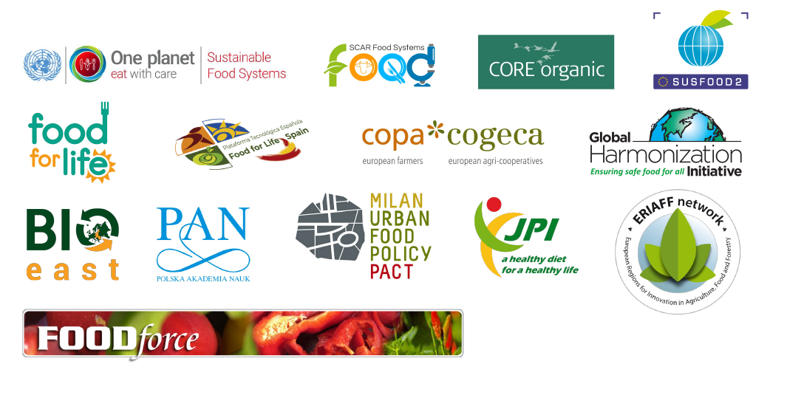

Who? > a vibrant community,
FOODPathS as network of networks, all over Europe and beyond
A wide range of public (local, regional, national, EU-wide, global), private (incl. SMEs & start-ups), research-education, philanthropic, NGOs, civil, etc. organisations.
www.foodpaths.eu
SRIA, page 55

Slide 7
The objectives of FOODPathS
The project aim: ‘FOODPathS’ will design the ‘Prototype SFS Partnership’.
The Prototype will serve as the first version of HOW the future Partnership may function:
WP3
Strategies for EU-MS joint funding actions
Exploring co-creation cases in FS Labs
Establishing the RIPE agenda
Analyzing trade-offs & co-benefits
Learning via exemplary universities
Adapting
Experimenting
WP7
WP4
Prioritizing
WP2
Collective governance & systemic actions, communication & coordination
WP8
Training
Evaluating
WP1
WP6
Focusing
WP5

Slide 8
Which relevant topics for Regions / ERIAFF ??
  FS approaches
  Funders forum,
  Vitrine with co-creation cases (vitrine),
  Sustainability charter,
  Exploitable SRIA (R&I, science-Policy & Education)
  List with trade-offs and co-benefits,
  Set of interactive communication tools
  New Modus Operandi
  Aligning new FS approaches?
  Co-funding strategies of regions?*
  City-region-SME-…-driven cases?
  Network of (regional) universities?
  Alignment with 3S strategies?
  Preserving region’s food cultural heritage?
  Connecting Regional Food Hubs?
  ..?
*workshop yesterday led by WP3

Slide 9
E.g. Aligning FS approaches with other Partnerships?
'Biodiversa+'
'Blue economy'
Agriculture of data
Animal health & welfare
'ERA4Health'
…
Sustainable Food
Systems Partnership
'Agroecology'
'Circular Bio-based Europe'
'Water4All'
'Chemical Risk Assessment'
EIT Food
…
Mirror groups in MS
‘Principles’: Diversity, Circularity, Adaptability, Fair & Just, Safety, One Health, etc.
System approaches
Observatory
FS Living Labs / Hubs
Communication

Slide 10
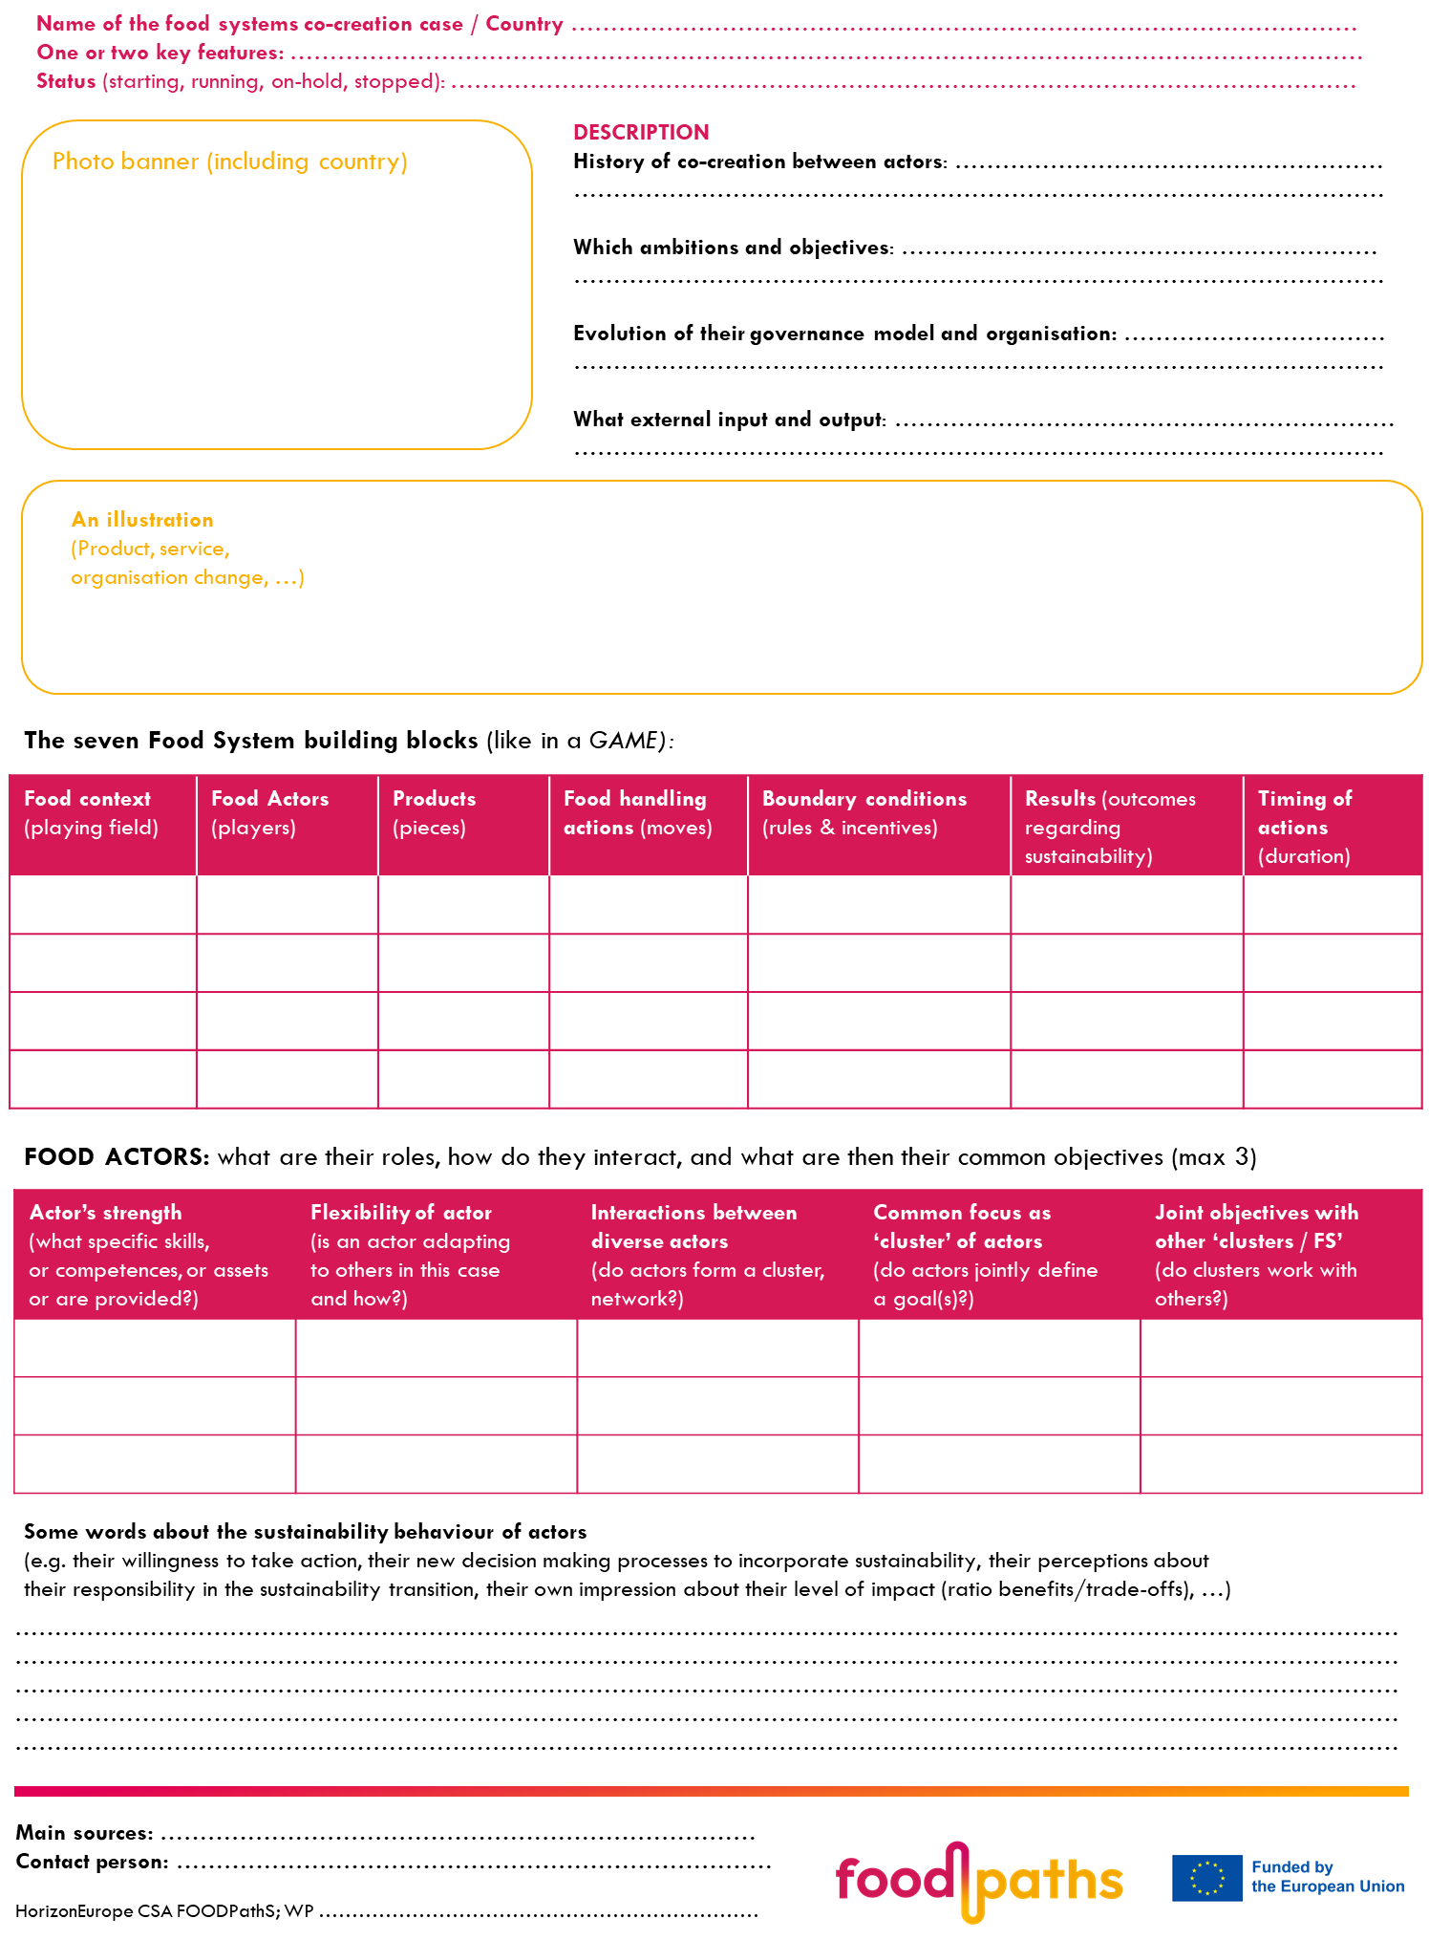
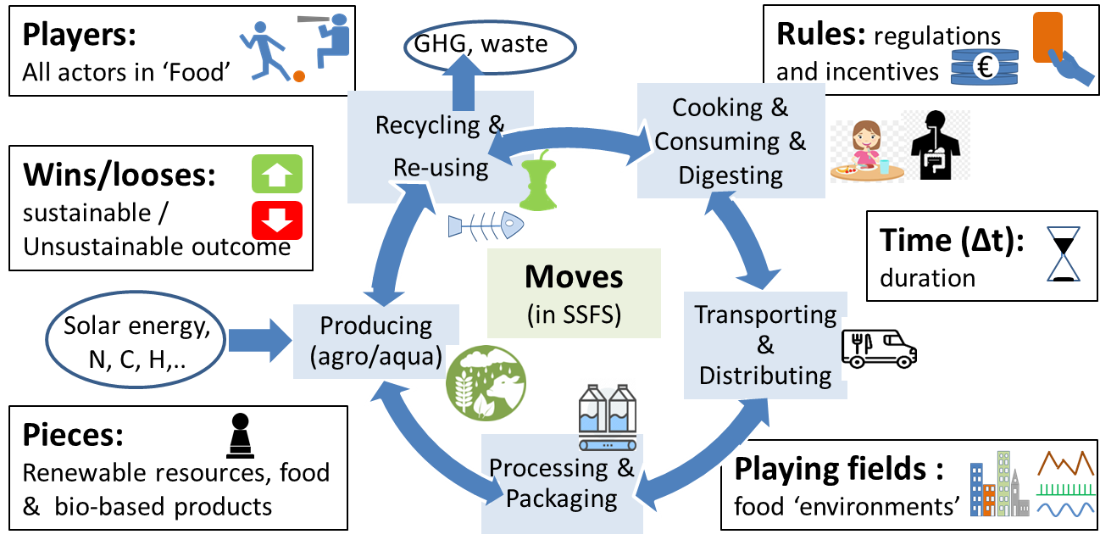
E.g. Presenting your regional FS cases in a joint ‘vitrine’
(please think about games that we all play)
Modified from: de Vries, Donner, Axelos 2022 in TIFS,
https://doi.org/10.1016/j.tifs.2022.03.027

Slide 11
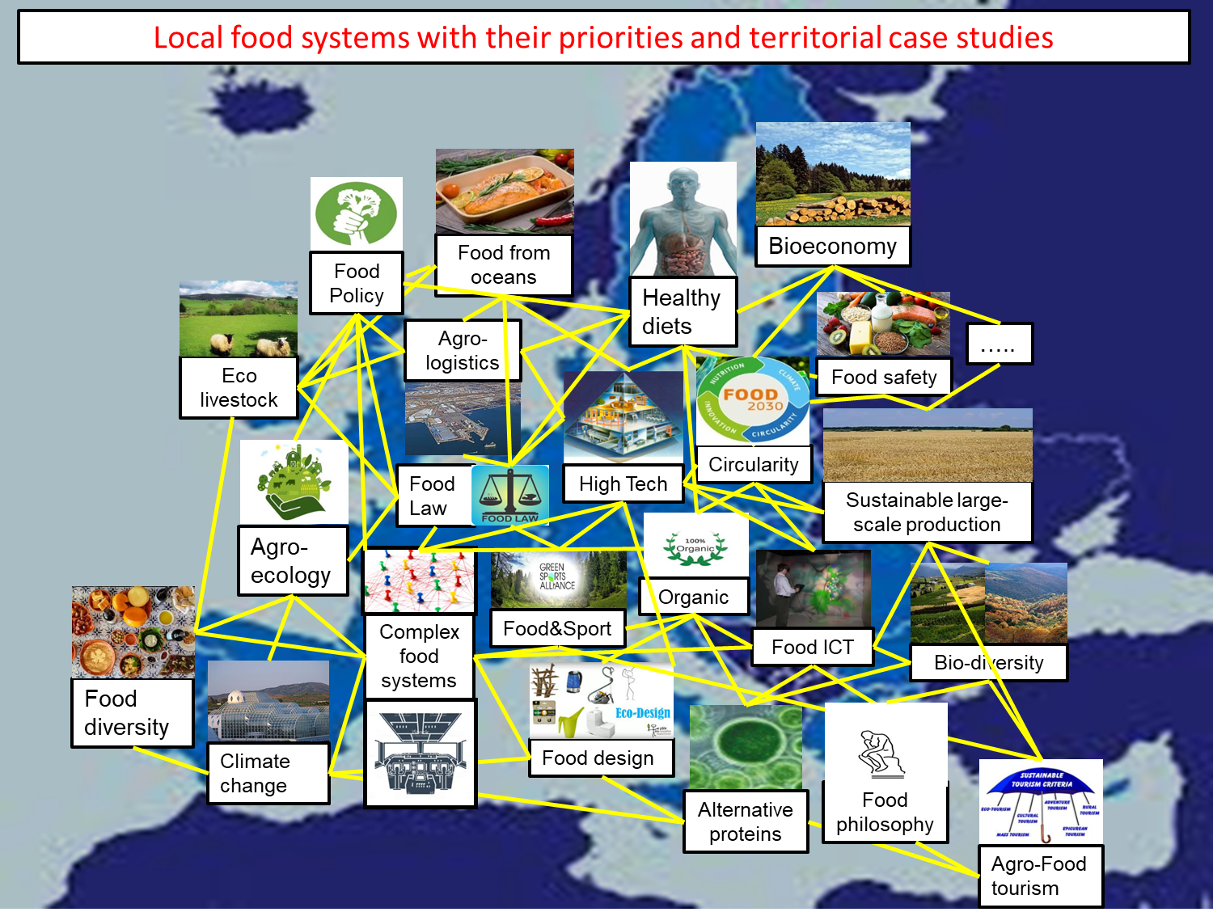
  E.g. Connecting Regional Food Hubs?
@INRAE HdV

Slide 12
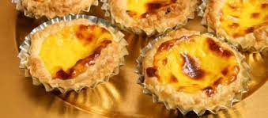
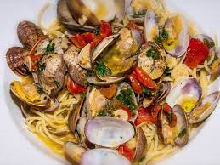
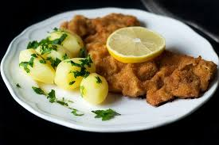
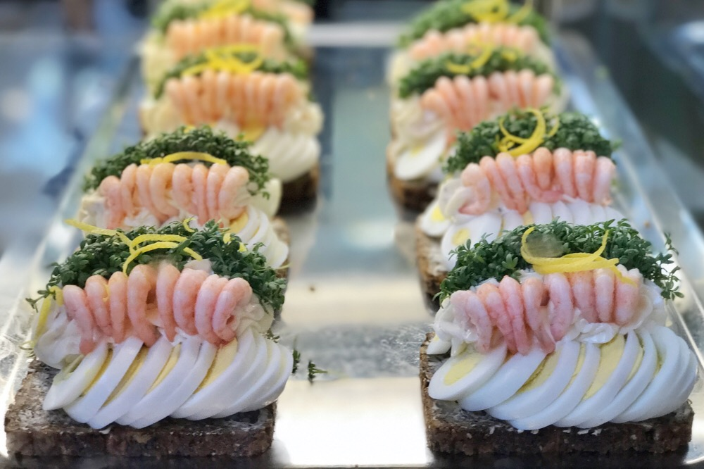
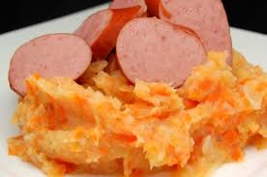
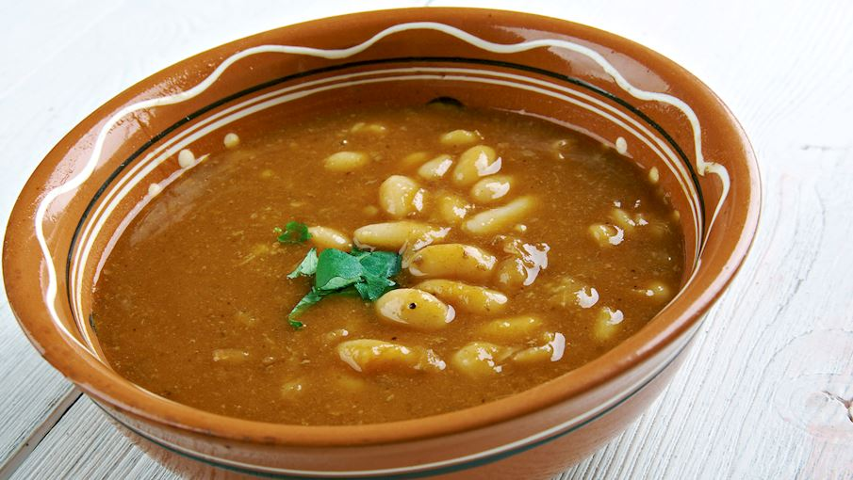
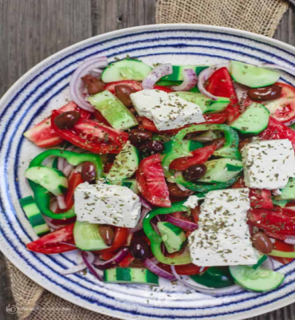
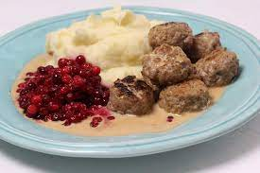
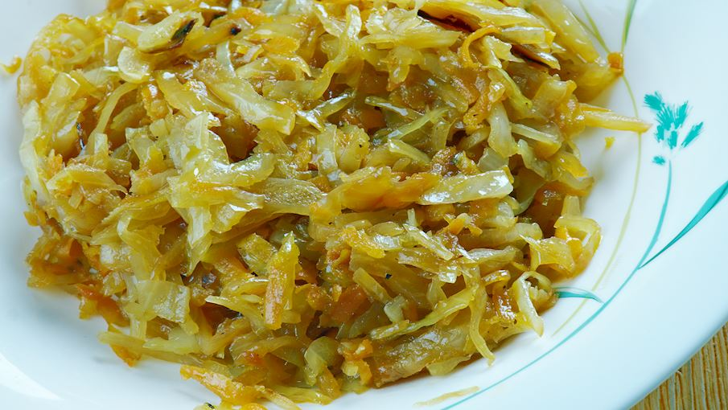
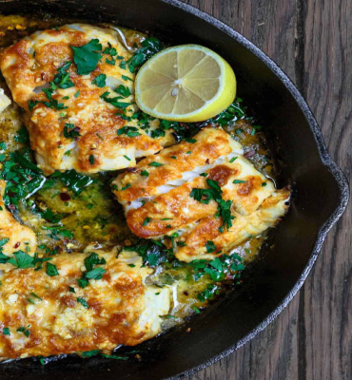
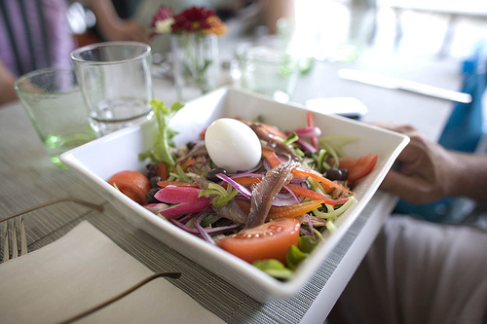
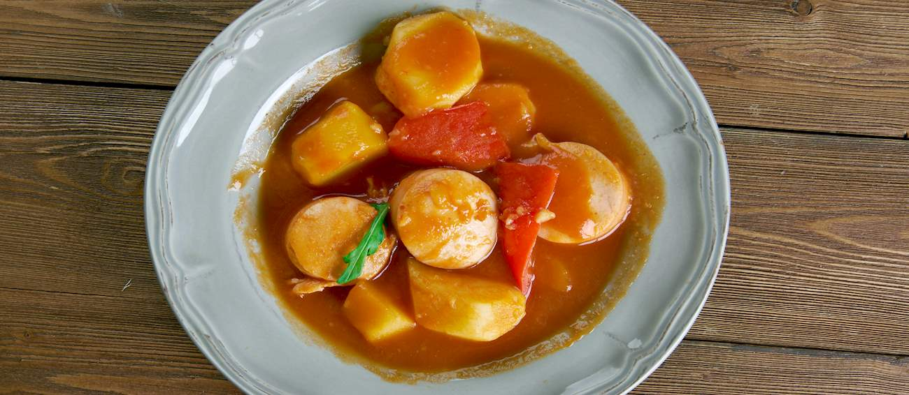
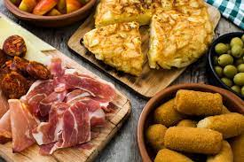
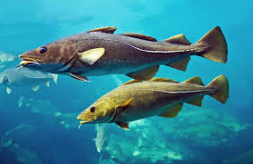
  E.g. jointly preserving our rich and divers, regional food cultural heritage > by proposing relevant R&I, policy & training topics?

Slide 13
Thank you for your attention!
'Regions hold the power to sustainably safeguard our rich European food cultural heritage’
hugo.de-vries@inrae.fr
INRAE, 23/5/2023

Slide 14
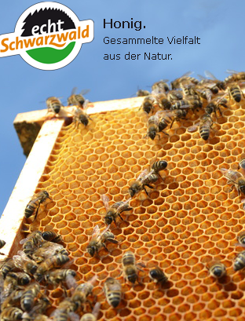
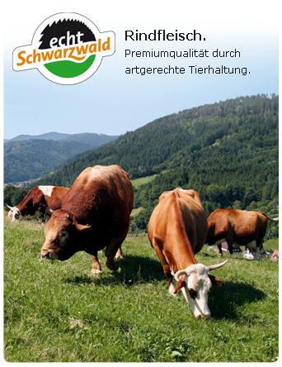


WP4 case: Echt Schwarzwald, Germany, started in 2008 – on going
Objective(s):
Protect the traditional natural landscape of the Black Forest (alternance between grassland and forest)
Price premium for specialty products
Keep grassland farming attractive and profitable
Key characteristics (cluster or innovation or ..)
- Collective place brand
- Local strategy

Slide 15
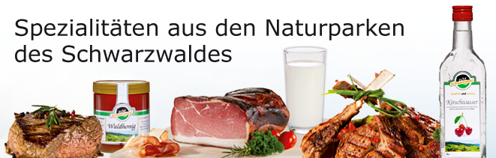
Food context (playing field) WHERE? | Key Actors (players) WHO? | Product / Asset (pieces) WHAT? | Major activity (moves) HOW? | Main boundary condition (rules) WHICH? | Main result (outcome) | Time (duration) WHEN?
Local (natural park Schwarzwald Mitte/Nord), in the South-West of Germany | local communities, two natural parks, the association with ca. 100 members consisting of farmers, butchers, restaurants, consulting agency in the beginning | local quality food products, mainly beef, pork, liquor, honey, milk | production, processing, distribution; food labelling | public support for brand development in the first 4 years; fulfilment of origin and quality requirements | contribution of the brand initiative to the preservation of the natural landscape, increase farmers income | 2008 – on going Public support for the first 4 years
Reference / web link: INRAE Mechtild Donner - https://www.echt-schwarzwald.de/

Slide 16
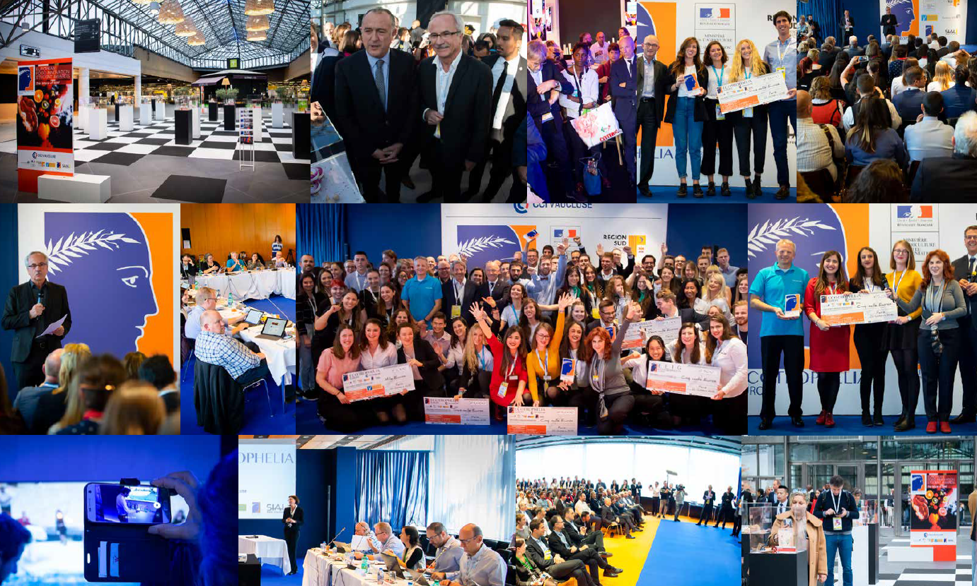
WP4 case: Ecotrophelia Europe – Started in 2008
Objective(s):
promote entrepreneurship and competitiveness within the European food industry by implementing a training network of excellence in food innovation
the organization of national and European food innovation competitions "The Student Awards of Food Innovation” a real eye-opener for the food industry
Key characteristics (cluster or innovation or ..)
Cooperation network gathering food industry representatives and academic partners
#innovation #youth #entrepreneurship

Slide 17
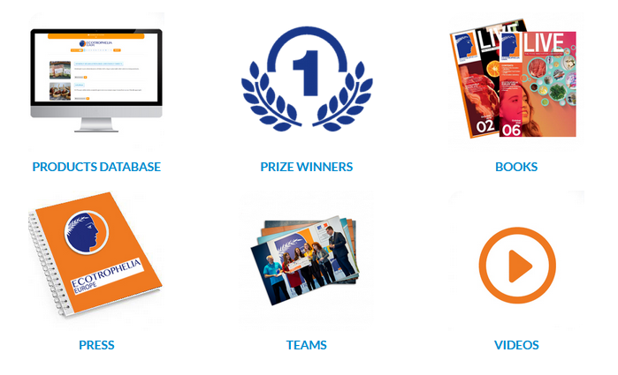
Food context (playing field) WHERE? | Key Actors (players) WHO? | Product / Asset (pieces) WHAT? | Major activity (moves) HOW? | Main boundary condition (rules) WHICH? | Main result (outcome) | Time (uration) WHEN?
European, but local | Food companies, representatives of universities | Innovative food products | A student competition | // champions league | Product database Students database New training methods | Yearly basis
Reference / web link: https://eu.ecotrophelia.org/

Slide 18
WP4 case: Regionally produced ‘artisanal’ bread

