Slide 1
Recent developments in recent regional Bioeconomies towards the Green and Climate transition
Bolzano, 22nd of May, 2023
Dr. Dr. h.c. Christian Patermann
Director ret., EU-Commission,
Member of the 1st Bioeconomy Council, Germany

Slide 2
Just to recall - Characteristics of biological resources
The uniqueness of some remarkable features of biological resources makes them attractive for becoming the possible fundament of an economy:
Their Renewability.
Their CO₂-“friendliness” or even sometimes carbon neutrality; central role of renewable carbon in the atmosphere and biosphere ("Renewable Carbon Initiative - RCI").
Their Re-use or multiuse, also in the format of cascades.
Their potentials for new, better functions in their products, e.g. higher stability, longer life, stronger endurance, less or no toxicity, less water use etc. what the EC recently qualifies as "biobased innovation“.

Slide 3
Additional USP‘s of the Bioeconomy
It is an ENABLING VALUE ECONOMY, strongly based on natural scientific knowlege, more than in any other existing economy or business model!
It is centered around adding values within value-chains, cross-regional and cross–sectorial. Most recent example: The updated Finnish Strategy of March 2022: ‘Sustainably towards higher value added’.
It is appreciating natural capital as a fundament in its concept
It is open for integrating knowledge produced by neighboring technologies, like nano, digital, AI, cognitive sciences etc. . Lately we note a powerful strategic and political movement from Latin America, in particular Brazil, to add traditional and indigenous knowledge.

Slide 4
Present status – Today
About 60 states worldwide and more than half a dozen regions officially support the bioeconomy either via dedicated programmes, strategies, action plans, roadmaps etc. or via closely related political, programmatic and/ or strategic activities, the majority of them still in Europe, the SuperBioPowers USA, China und India, however the latter on catching up.
Elaboration of new regional strategies is however slowing down
Recently more and more new strategies focus more on biotechnology, biomanufacturing and biofuel production and use.
Today, almost 18 years after it‘s launch there is no more a single bioeconomy but there are many bioeconomies! Continental discrepancies become however more evident.

Slide 5
Present status (cont.)
This has an impact on the necessary frameworks, public funding, private investment and thematical content.
In 2021 Uruguay published its strategy, the autonomous Spanish regions Catalonia in September and Basque region in October 2021 as well as Portugal, with a dedicated Action Plan.
In 2022 Finland updated its strategy for 2014 in March 2022, followed by the Republic of China with its first national Bioeconomy Plan within its 14th 5-Years-programme: "Bioeconomy is life sciences and biotechnology ".

Slide 6
Present status (cont.)
The USA published in 2022 its so-called “Biotechnology and Biomanufacturing Initiative” (Advancing BIOTECHNOLOGY and BIOMANUFACTION INNOVATION) for a sustainable, safe and secure AMERICAN Bioeconomy – BBI).
Queensland and Namibia elaborated their national, respective regional own strategies.
In 2023 we expect Sweden, Croatia, Estonia and New Zealand announcing their new bioeconomy strategies; India announced its own “Biomanufacturing and Biotech Strategy” with strong references to the US_ BBI for end of 2023.

Slide 7
Present status (cont.)
In Germany, the recent coalition agreements in the German States of North Rhine-Westphalia and Lower Saxony foresee new regional bioeconomy strategies, including the establishing of proper Bioeconomy Advisor Councils (Bioökonomierat) for their Länder. North Rhine-Westphalia will strongly focus on Green Chemistry and the transformation of relicted brownfield regions to so-called bio-reservoirs, the bioeconomy being one of the main strategic pillars.

Slide 8
Present status (cont.)
Strong multilateral moves to boost the bioeconomy globally during the 2nd half of 2021: G-20 meeting in Rome in July 2021 under Italian Presidency, UN Food Systems Summit (UNFSS) in September 2021 in New York, with Bioeconomy and One Health as important scientific priorities; World Bioeconomy Forum in Belem, Brazil in October 2021, focusing on tropical forests.
APEC, the Asian Pacific Economic Cooperation Organization in its so-called Bangkok Goals of August 2022 states the BCG Economy Model as the future model for this huge region: BioCircularGreenEconomy, however still widely open in its content!

Slide 9
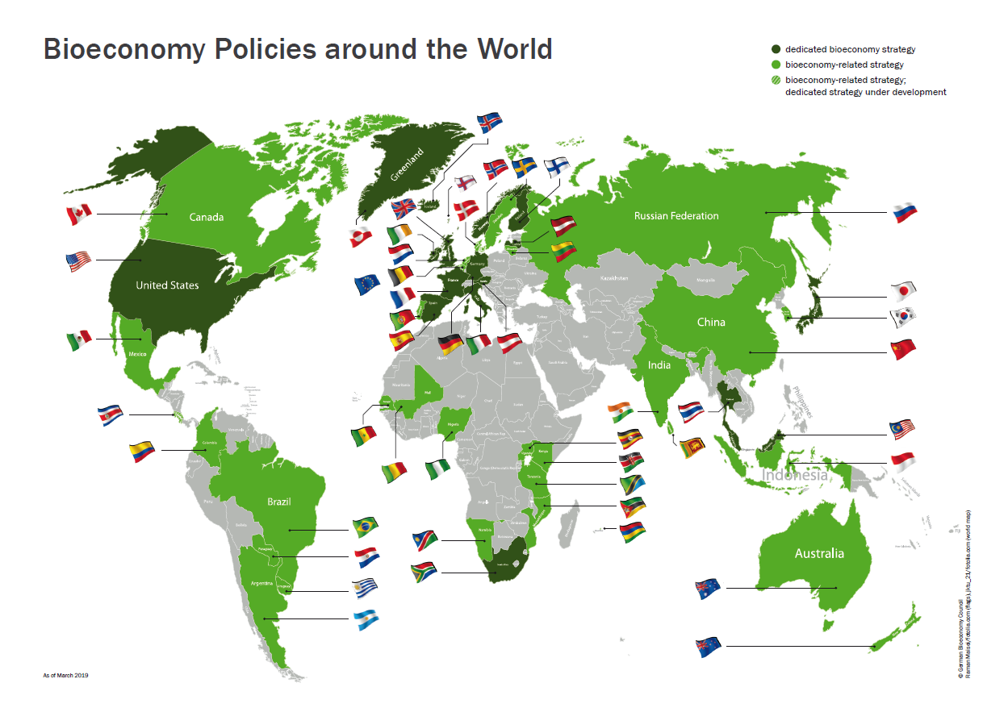
Source: National Bioeconomy Council, BÖR, March, 2019

Slide 10
Circularity element - a principle of biology – is getting more relevant!
Circular economy and the bioeconomy are true partners in sustainability! Excellent contribution by the European Environmental Agency in Copenhagen, EEA from 2018.
Some practical illustrating examples:
Biorefining;
3-D printing with bioplastics;
Multipurpose crops;
Valorizing residues, in particular food waste!

Slide 11
Developments in the USA
The main priorities in the new updated USA Bioeconomy Initiative BBI, also showing strong differences to the European topics, are:
Health
Harnessing Biotechnology and Biomanufacturing R&D for further Societal Goals including Climate Changes
Data for the Bioeconomy
Biobased Products Procurement
Biotech- and Biomanufacturing Workforce
Biotechnology Regulation Clarity and Efficiency
Reducing Risk by Advancing Biosafety and Biosecurity, and Assessing Threats to the United States Bioeconomy

Slide 12
Developments in the USA (cont.)
In addition, the U.S. White House has published recently various follow-up actions making their biobased initiatives more concrete:
the Department of Defense owns a proper biomanufacturing strategy with a first budget of 1.5 Billion $
among the so-called Bold Goals the development of dedicated climate actions, but also the strengthening of the resilience of value
chains appear as new topics
the White House clearly takes the lead in the implementation of the USA Bioeconomy.

Slide 13
Additional recent trends
More attention is recently paid to the biobased closing of waste cycles, hereby contributing to a better supply of so-called rare and/or critical raw materials (CRM), like Lithium, Phosphorous, Cobalt etc., important for technologies developing E-mobility, additive manufacturing, 3-D and 4-D printing, artificial intelligence, but also water reuse, etc.: All very relevant industrial and technological topics of this new decade! These aspects of optimizing CRM's availability, so-called “Raw Materials Safety" is hitherto strongly underestimated in former and present discussions on the potentials and goals of a circular Bioeconomy, but is gaining momentum.

Slide 14
Additional recent trends (cont.)
Stronger emphasis on “soft skills” to enable or to optimize the implementation of biobased economies:
New ways for funding: Launch of the ECBF (European Circular Bioeconomy Fund) by the EU and the EIB, with first closes end of last year; new initiatives to support private investments for the Bioeconomy by tax incentives, special coaching and information actions for family offices, investment fund managers, PE actors, mobilizing the potentials of COOPERATIVES etc..

Slide 15
Additional recent trends (cont.)
New ways for academic and vocational training and education connecting educational platforms among more than 30 European universities, offering bachelor and master courses; implementation of the concept of a European Bioeconomy University; anchoring of bioeconomy as a subject for teaching and learning in curricula of primary and secondary schools (e.g., in the Strategy of Bavaria).
New ways of communication, including stronger focus on younger people, kids, students etc., but also on specific “interest groups“ like teachers, journalists, influencers etc.

Slide 16
Additional recent trends (cont.)
The pandemic will also trigger new trends, i.e. paying more attention to
livestock issues within the context of biological resources, focusing more on biodiversity
health, as an issue in the Global Bioeconomy Agenda…UNFSS
food supply, ranging from animal welfare, reduction of meat consumption to production of alternate plant-based proteins (Burger without meat, or milk without a cow etc.)
Strong focus on corona-oriented new value-chains, like virus-resistant or virus-free food packaging materials, smart alternate proteins or new biomaterials for personal protective equipment (PPE) etc.

Slide 17
Additional recent trends (cont.)
Until today, the role of livestock, for example grazing animals and their contribution to preserve biodiversity as well as the role of insects as biological resources have been widely ignored in European RTDI.

Slide 18
Bioeconomy and the regions
All these given trends cannot be divided in national or regional impacts: They will in an equal manner influence national and regional activities, for one simple reason:
the bioeconomy will only fly if it flies locally and regionally. The need for scaling up biobased activities is more than evident all over Europe.

Slide 19
Bioeconomy and the regions (cont.)
This is more than true for rural, but also pre-urban and urban areas; in the latter ones there is still not a single urban Bioeconomy strategy existing;
Baden Württemberg has just finished a call to trigger such activities known as “Kommunale Bioökonomie-Strategien”.
Let’s see.

Slide 20
Thank you for your attention!

