Slide 1
EIP-AGRI Operational Groups:
Opportunities for reinforcing interregional collaboration within the European Union
Pacôme Elouna Eyenga - Team Leader EIP-AGRI SF
European CAP Network
Innovation & Knowledge Exchange I EIP-AGRI
ERIAFF ANNUAL CONFERENCE 2023
22-24 May 2023
Bolzano, Italy

Slide 2
Content:
The European CAP Network (EU CAP Network)
EIP-AGRI Operational Groups: State of play
EIP-AGRI Operational Groups in the new CAP

Slide 3
1. European CAP Network
(EU CAP Network)

Slide 4
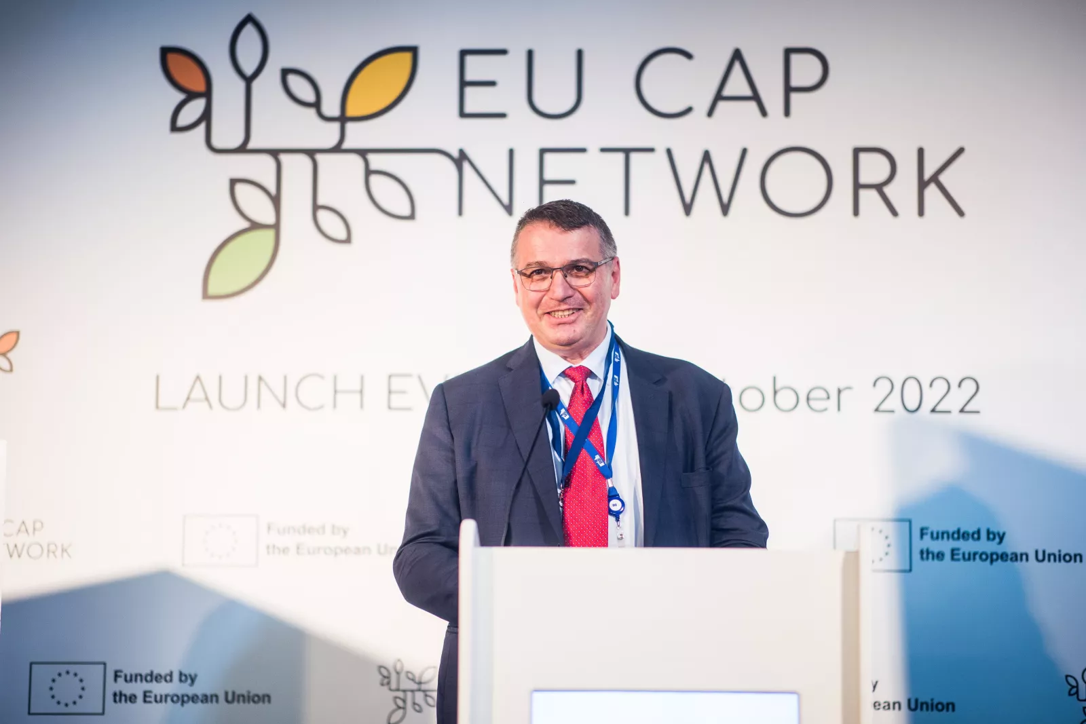
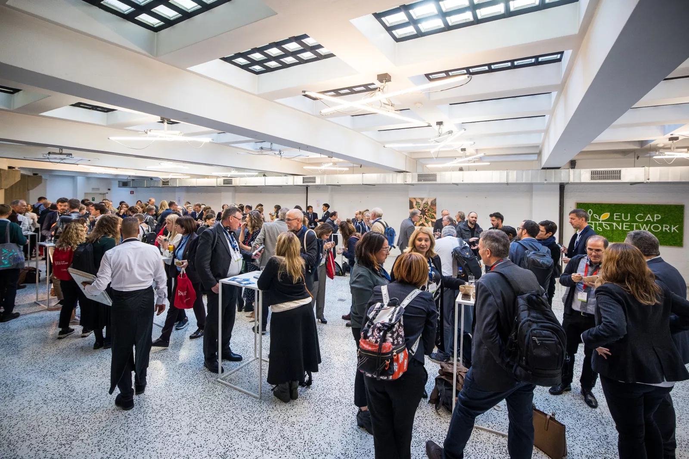
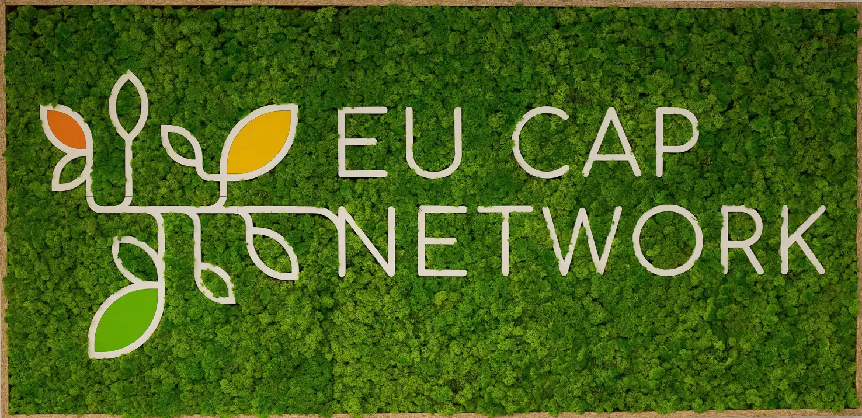

1. European CAP Network (EU CAP Network)
Launch event 6 October 2022 in Brussels
EIP-AGRI Network + ENRD = EU CAP Network
For the networking of national networks, organisations, and administrations in the field of agriculture and rural development

Slide 5
New visual identity
1. European CAP Network (EU CAP Network)
Support for Innovation & Knowledge Exchange I EIP-AGRI
Support for Evaluation & Monitoring
Support to CAP Strategic Plans Implementation
Cross-cutting Support for Communication & Logistics

Slide 6
1. European CAP Network (EU CAP Network)
MAIN OBJECTIVES (EC Regulation Article 126 - National and European CAP networks):
Increase the involvement of all relevant stakeholders in the implementation/design of CAP SPs
Accompany the Member States' administrations in the implementation of CAP Strategic Plans and the transition to a performance-based delivery model;
Contribute to improving the quality of implementation of CAP SPs
Contribute to the information of the public and potential beneficiaries on the CAP and funding opportunities
Foster innovation in agriculture and rural development and support peer-to-peer learning and the inclusion of, and the interaction between, all stakeholders in the knowledge-exchange and knowledge building process;
Contribute to monitoring and evaluation capacity and activities;
Contribute to the dissemination of CAP Strategic Plans results.

Slide 7
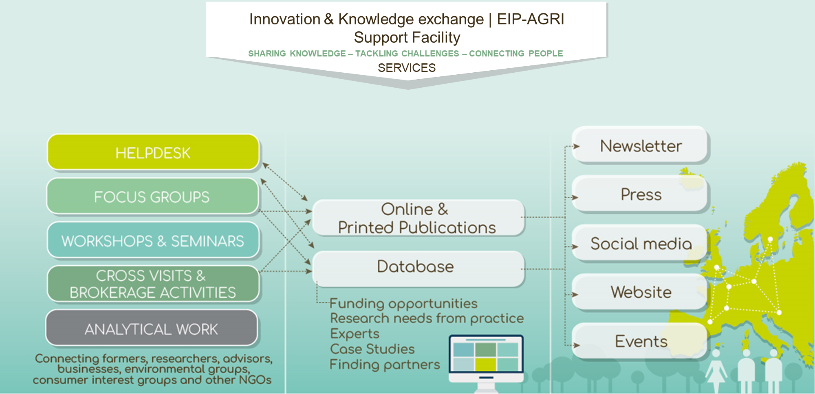



Slide 8
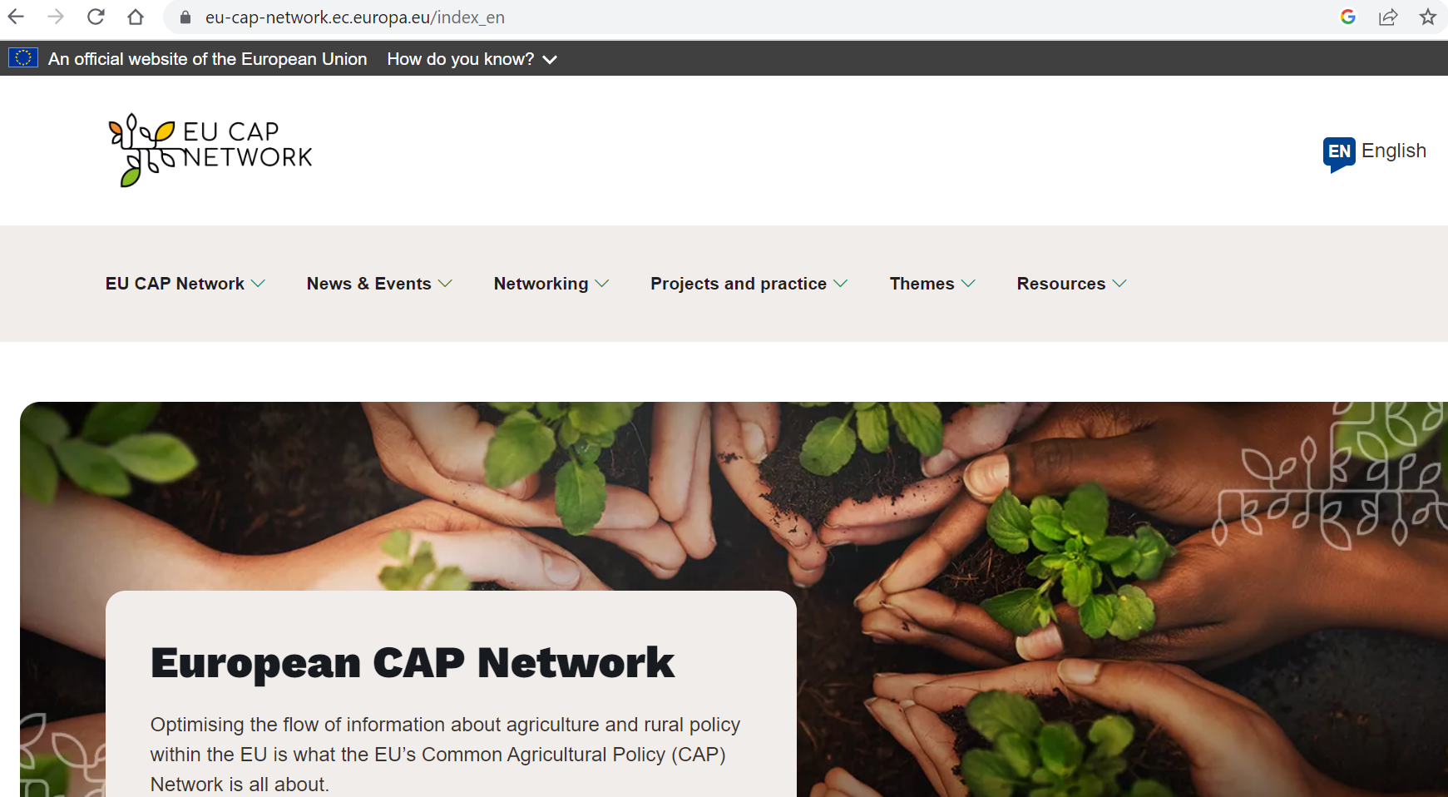
New website: https://eu-cap-network.ec.europa.eu
1. European CAP Network (EU CAP Network)
Corporate communication

Slide 9

1. European CAP Network (EU CAP Network)
Corporate communication
New social media accounts
Facebook – @EU CAP Network
Twitter - @eucapnetwork
LinkedIn - @EU CAP Network
YouTube - EU CAP Network
Official hashtags
#EUCAPNetwork
#BloomTogether

Slide 10
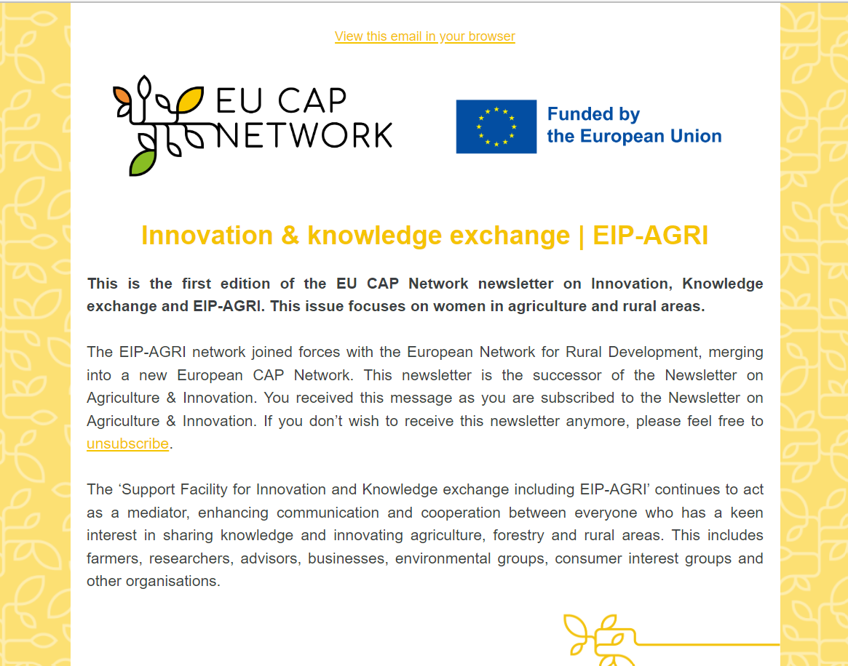
1. European CAP Network (EU CAP Network)
Corporate communication
2 Newsletters
Monthly newsletters
Innovation & Knowledge Exchange | EIP-AGRI
EU CAP Network
Subscribe here

Slide 11
2. EIP-AGRI Operational Groups:
State of play

Slide 12
European Innovation Partnership for agricultural productivity and Sustainability (EIP-AGRI) :
2. EIP-AGRI Operational Groups: State of play
Launched by the Commission Communication in February 2012
Aim: to stimulate innovation and improve the exchange of knowledge
Approach: Closing the innovation gap between research, innovation and practice by:
  using the interactive innovation model (EIP-AGRI operational groups)
  linking actors via the EU CAP Network (broad range of networking activities and events)

Slide 13






EIP-AGRI connecting policies: the bigger picture
Common Agriculture Policy
(national/regional)
Horizon 2020/Europe
  Research projects (EU):
  Multi-actor projects
  Thematic networks
National CAP Networks
Operational Group
Unique EU knowledge repository
of contacts and practice abstracts
  OG preparation
  OG projects
  Innovation support services
Spread
the results
Involvement of OGs
strongly recommended
Welcome to the EU CAP Network! | European CAP Network (europa.eu)

Slide 14
2. EIP-AGRI Operational Groups: State of play
What did we achieve from 2014 to 2022 ?
Data from FSC in April 2023
26 Member States + UK, 98 RDPs implementing EIP OGs’ ”innovative projects”
3 200 OGs planned; around 2788 OGs running or finished.
Not included in SFC: Greece - 287 OGs, Cyprus -

Slide 16
3. EIP-AGRI Operational Groups in the new CAP

Slide 17
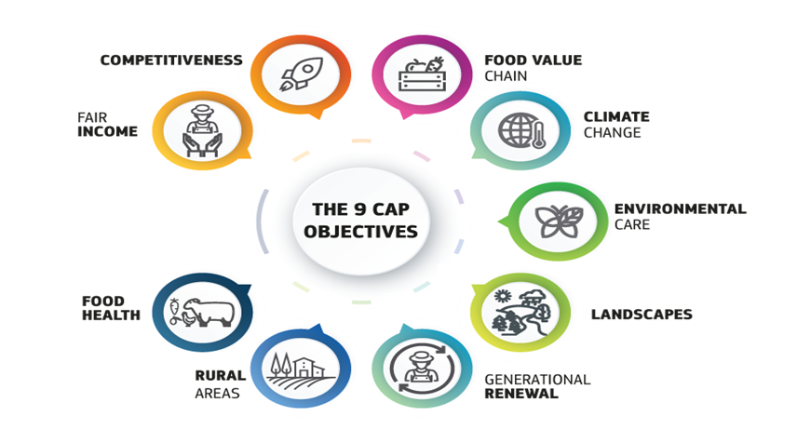
EC Regulation Article 127 - European Innovation Partnership for agricultural productivity and sustainability
3. EIP-AGRI Operational Groups in the new CAP
Where are we going ?
EIP operational groups may act at transnational, including cross-border, level. The envisaged innovation may be based on new practices, but also on traditional practices in a new geographical or environmental context.
2023-2027
25 Member States implementing EIP OGs ”innovative projects”
Over 6 600 OGs’ projects planned

Slide 18
3. EIP-AGRI Operational Groups in the new CAP
Support from Innovation & Knowledge Exchange I EIP-AGRI strand of EU CAP Network
  Brokerage Activities as integral parts of Seminars, Workshops and Conferences
  Stand – alone brokerage activities
  Exchange fora for innovative projects and actors to meet each other, discuss potential project ideas or other forms of cooperation…
    HORIZON-CL6-2023-GOVERNANCE-01-18: Broaden EIP Operational Group outcomes across borders by means of thematic networks to compile and share knowledge ready for practice.

Slide 19
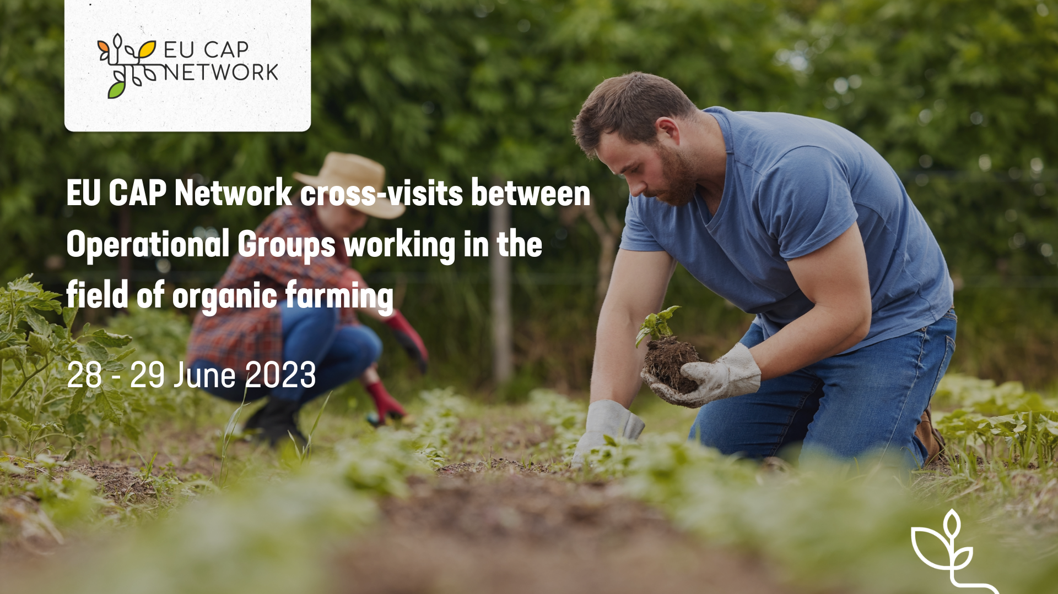
3. EIP-AGRI Operational Groups in the new CAP
Support from Innovation & Knowledge Exchange I EIP-AGRI strand of EU CAP Network
Cross – visits: multiple and one to one
  To provide cross-border exchange possibility between Operational Groups, from minimum two different Member States.
  The main goal is to:
  enable peer-to-peer learning and exchange on the innovations that the involved projects address;
  discuss common challenges and potential solutions;
  exchange and further disseminate project findings across the EU;
  establish future collaborations and/or partnerships.

Slide 20
3. EIP-AGRI Operational Groups in the new CAP
Support from Innovation & Knowledge Exchange I EIP-AGRI strand of EU CAP Network
EU CAP Network cross-visits between multiple Operational Groups working in the field of organic farming more specifically:
  Organic farming supply and value chain optimization
  Circular and organic soil management
The locations of the visits will be selected based on the outcomes of the call for interest.
The cross-visits will take place in parallel on Wednesday 28 – Thursday 29 June 2023.
The working language during the cross-visits is English and there will be no interpretation.
The call is now open and will close on 25 May 2023 (23:59 CET
EU CAP Network cross-visits - call for expression of interest now open | European CAP Network (europa.eu)

Slide 21
THANK YOU VERY MUCH !
innovation-knowledge@eucapnetwork.eu
+32 2 543 72 81
EIP-AGRI Support Facility
Koning Albert II laan 15
1210 Brussel
Belgium

