Slide 1
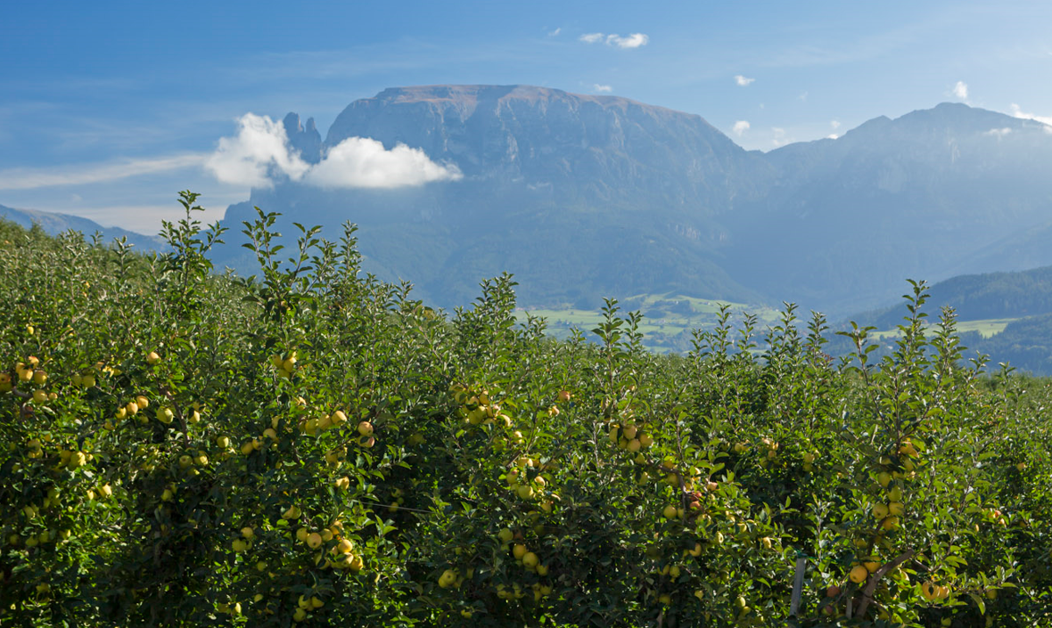
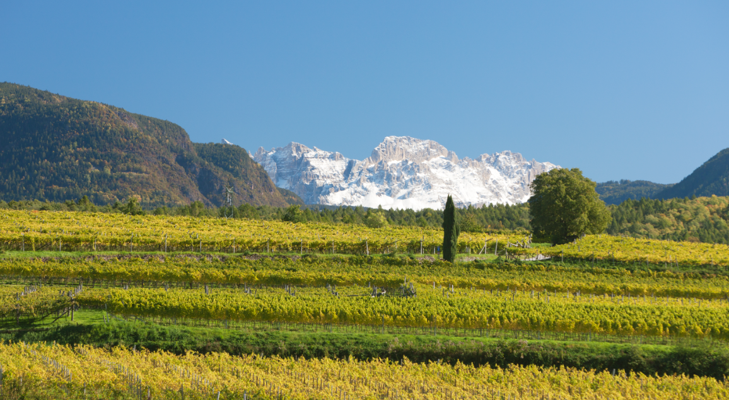
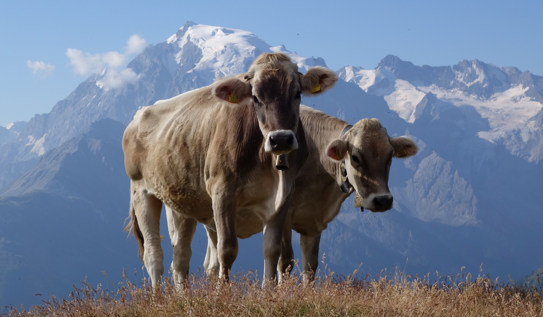
agriculture 2030:
South tyrol‘s Path to sustainability
Presentation of the action plan

Slide 2
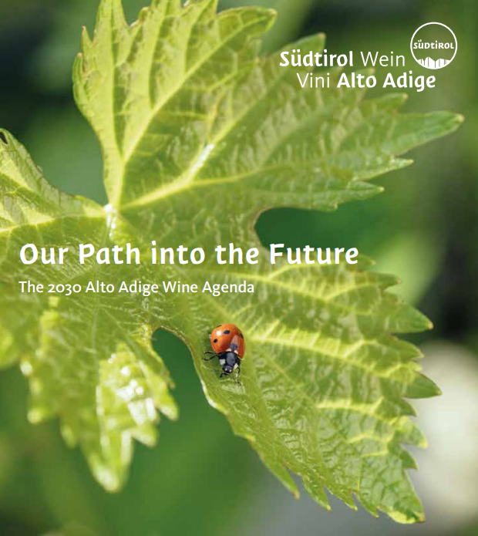
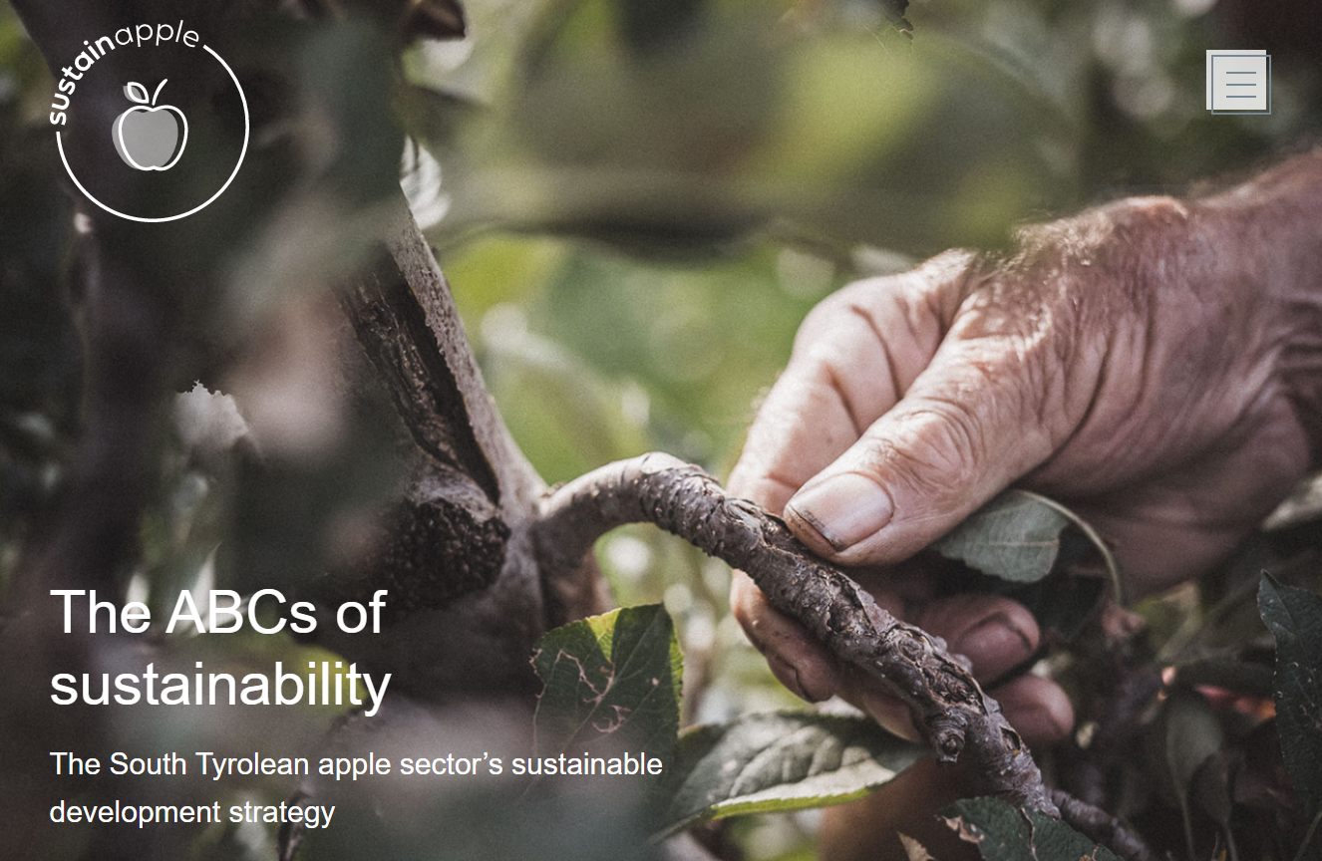
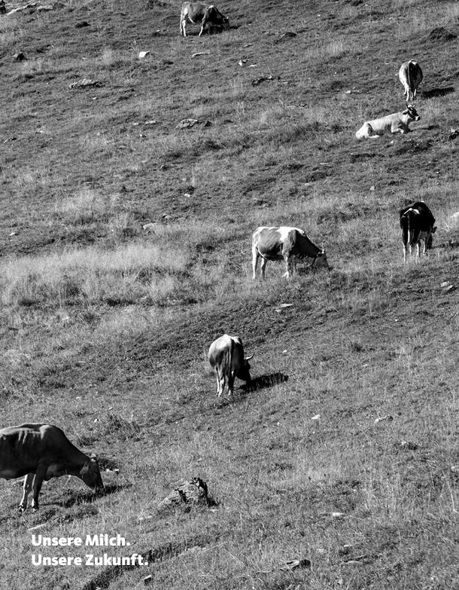
agriculture 2030: south tyrol‘s path to sustainability
Sustainability concepts of the sektors
South Tyrolean Wine Agenda 2030
Sustainapple
Sustainability report Milk
Strategy paper AGRICULTURE 2030
Guiding Principles and Lighthouse Projects des Südtiroler Bauernbundes
Notes:
Schnittmengen, hier ist der Platz für übergreifende Projekte

Slide 3
Action plan agriculture 2030
What?
Catalogue of measures for the implementation of the Strategy Paper for South Tyrolean Agriculture 2030+
Ongoing monitoring process
Content:
Projects of the South Tyrolean Farmers‘Union, the sectors, the public administration and scientific institutions
Why?
Overview and continuous updating of the projects
Coordination and exchange ensured

Slide 4
Fields of action
Family business & rural area
Climate & CO₂-Reduction
Water & Soil
Biodiversity & landscape
Health & Happiness
Society & Dialogue
Monitoring & Digitalisation

Slide 5
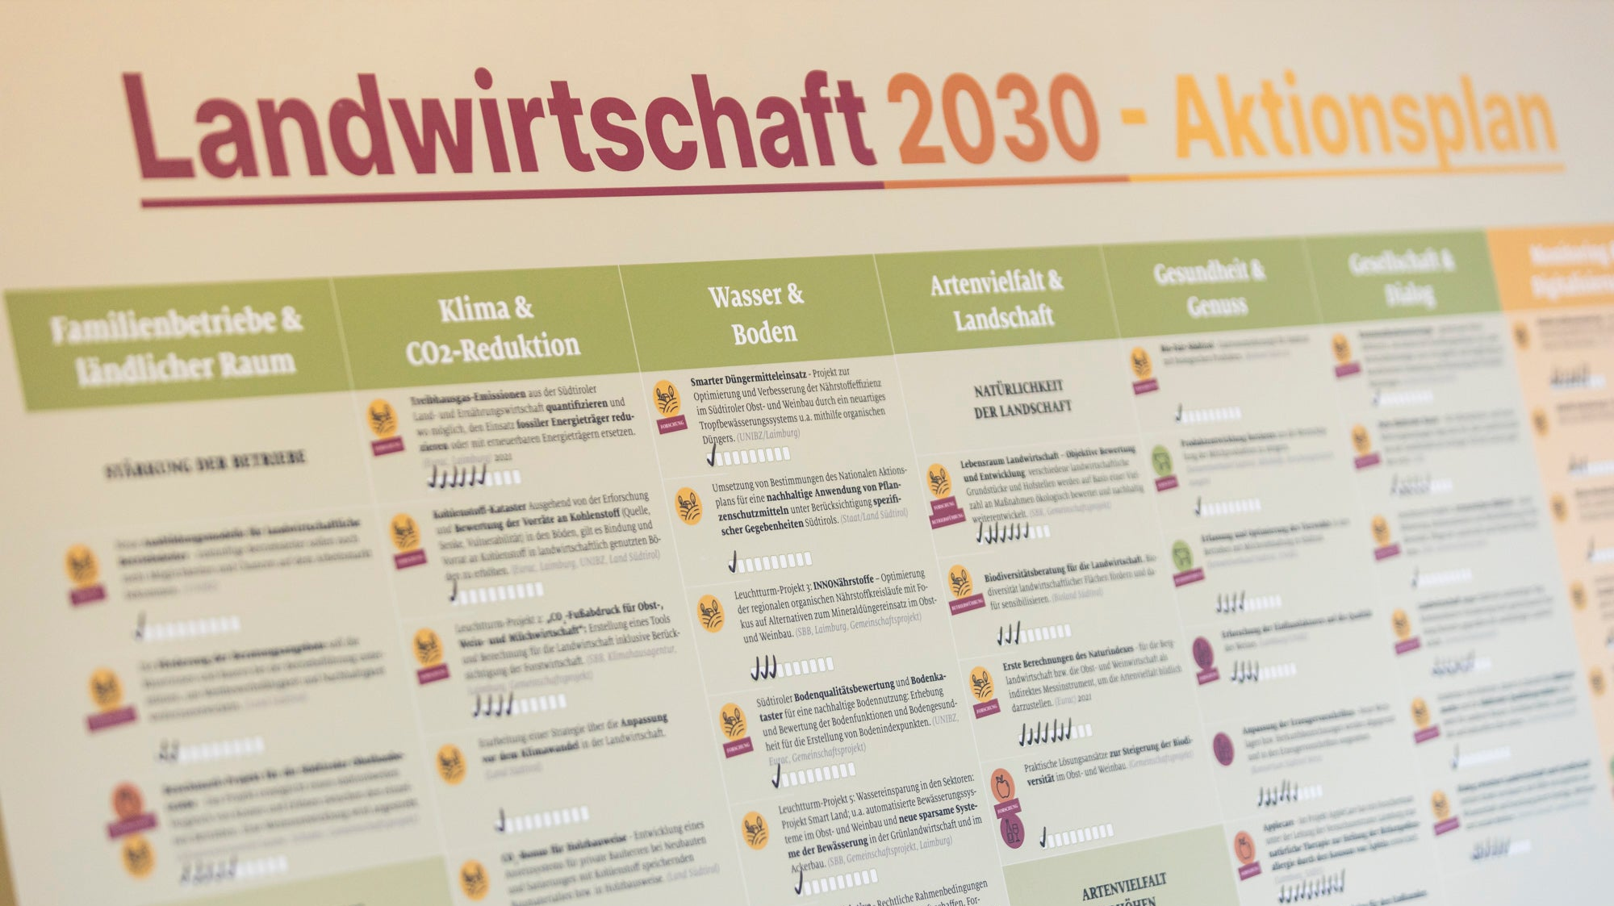

Slide 6
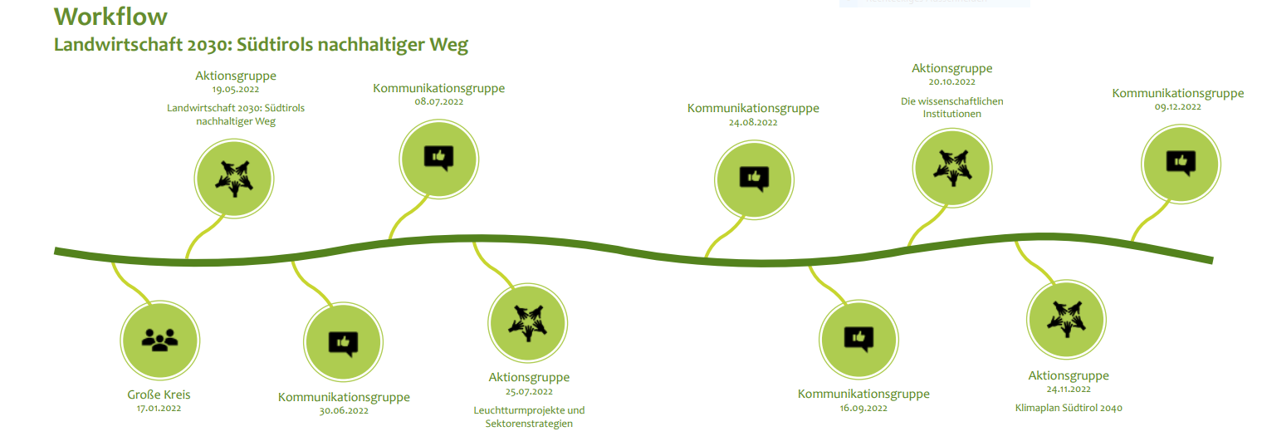
Workflow
Agriculture 2030: South Tyrol‘s path to sustainability
Action group
19.05.2022
Communication group
08.07.2022
Action group
20.10.2022
The scientific institutions
Communication group
24.08.2022
Communication group
09.12.2022
Action group
25.07.2022
Action group
24.11.2022
Climate plan South Tyrol 2040
Large group
Communication group
30.06.2022
Communication group
16.09.2022
Lighthouse projects & strategies of the sectors

Slide 7
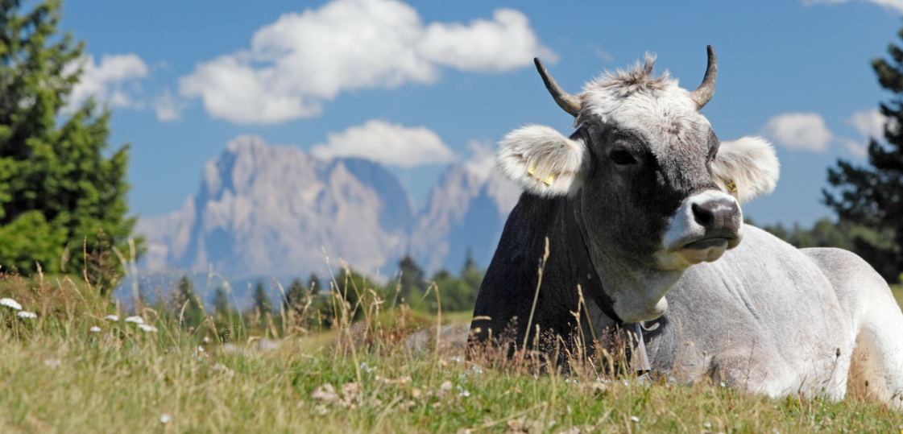
Thank you for your attention

