Slide 1
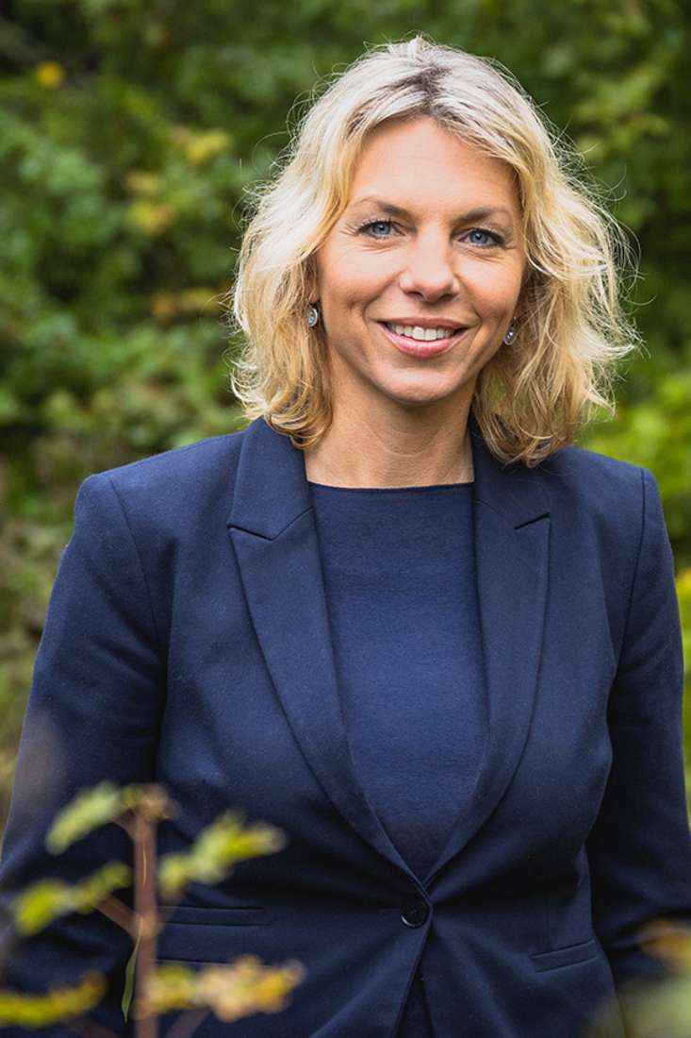
„Forest action plan 2030 ff“ Thuringia´s contribution on securing the future of forests
Susanna Karawanskij
Thuringia´s Minister for Infrastructure and Agriculture
Bozen/Bolzano, Südtirol/Alto Adige
22. Mai 2023
© Daniel Santana, Referat M3 / TMIL

Slide 2
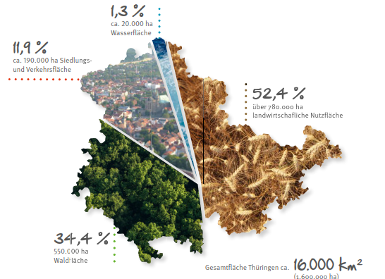
Forests – Thuringia´s riches
Thuringia is one of the most densely forested federals states in Germany
Around 550,000 hectares and thus 34% of the country's area are forest
Distribution of forest ownership: 43% private forest, 16% communal forest, 41% state forest
approx. 40,000 jobs in forestry and forestry management

Slide 3
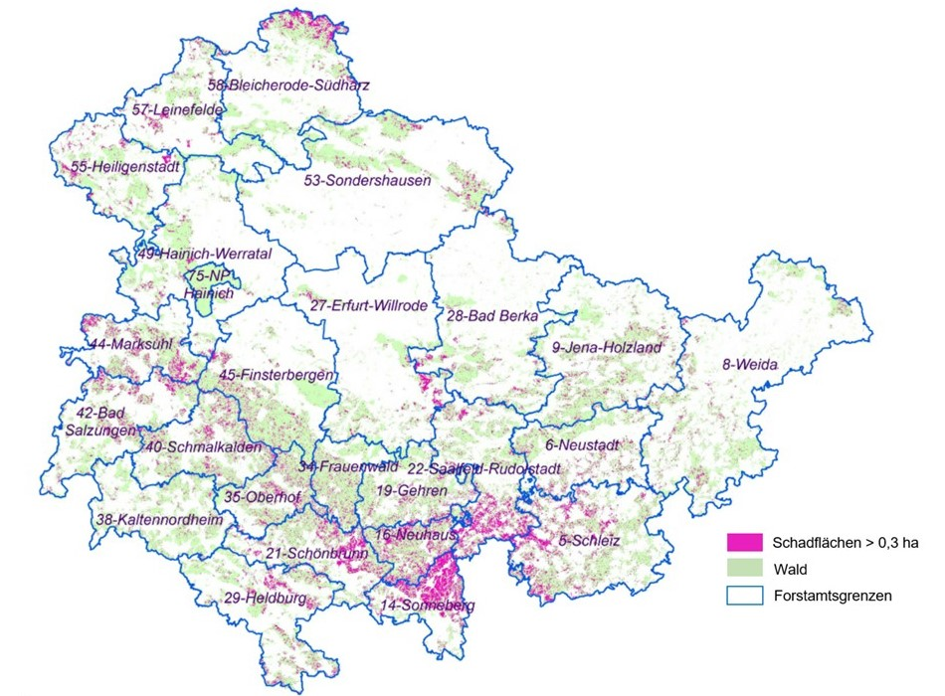
Climate consequences for Thuringia's forests
Climate change occurs abruptly in forests!
Thuringia's forests significantly weakened in vitality and resilience since 2018
14% of the forest area in Thuringia is considered damaged(76.600 hectare)
More than 22 million solid cubic meters of damaged timber accumulated to date

Slide 4
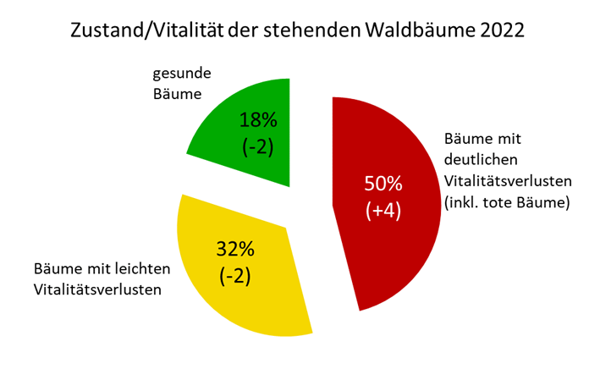
Climate consequences for Thuringia's forests
Forest condition survey 2022: only 18% of all trees still vital, 50% significantly damaged
all tree species affected by the damage
predominant part of the damaged areas concerns former spruce stands (2012: spruce present on about 38% of forest area, since 2018 calamity-related decline.)
Beech trees as Thuringia's natural character tree species also suffer from drought

Slide 5
Causes of the damage
Drought
Lack of precipitation or insufficient precipitation since 2018
Consequence: water shortage/drought in the forest floor
Bark Beetle
75% of the amount of damaged wood caused by beetles (3.8 Mio. solid cubic meters)
1. quarter 2023: already more than 550.000 solid m³ beetle infestation (new record!)
Forecast: also in 2023 same amount of damaged timber like in 2022
Forest Fires
Drought-related increasing hazard potential for forest fires
2022 forestfires on 22 hectares of land (highest area value in 30 years)
Storms
Threat of storms especially in winter months
Damage by storms „Kyrill“ (2007), „Friederike“ (2018), „Eberhardt“ (2019), „Sabine“ (2020), „Ylenia“, „Zeynep“ and „Antonia“ (alle 2022)

Slide 6
Forest action plan 2030ff.
Cabinet decision August 2019
Interdepartemental programm
formulated and includes package of measures to develop the forest in climate change for future generations in a future-proof manner (Keywords: damage management and forest restructuring)
Financial resources for the action plan until 2030: 500 million euros
Thematic fields of the Forest Action Plan
1) Systematic recording of the damage situation/forest environmental monitoring
2) Wood processing, storage, logistics
3) Sustainable forest conversion
4) Forest Fire Protection
5) Sustainable building/example effect of the public sector
Additional measures:
State Forestry Office ThüringenForst as Competence Center for Forest Conversion
Support of applied forestry research and forestry experimentation as well as cooperation between agriculture and forestry (also on European level within ERIAFF, EUSTAFOR, Association of private forest owners)

Slide 7
Financial support for forests
2019 until 2022: 16 Mio. Euro for ThüringenForst to cope with damage caused by drought, storms and bark beetle infestation
From 2023, 30 million euros annually for active technical support for private and municipal forest owners by ThüringenForst
Special Program Forest Restoration and Reforestation 2021-2036 : 11 Mio. Euro in special allocations to ThüringenForst (=176 million euros) for consulting, research, monitoring in the context of reforestation of damaged areas and planned forest conversion
Improved support for municipal and private forest owners in Thuringia: 2023, 25 Mio. euros are earmarked for financial support for forest aid (five times as much as in 2018)
Funding priorities since 2020: „Coping with extreme weather events“ (2022: 10,3 Mio. Euro) and „near-natural forest management “ (2022: 3,8 Mio. Euro)
Rewarding ecosystem services 2021: 15 Mio. Euro → Pioneering role within Germany
Special Federal "Climate and Transformation Fund" 2022-2026: nationwide 900 Mio. Euro grants for climate-adapted forest management practices

Slide 8
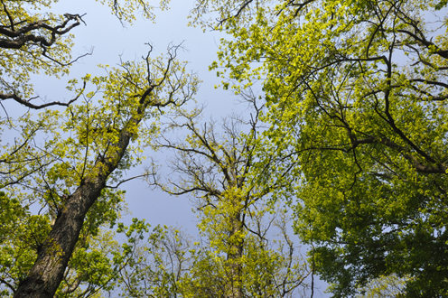
Thank you for your attention!

