Slide 1
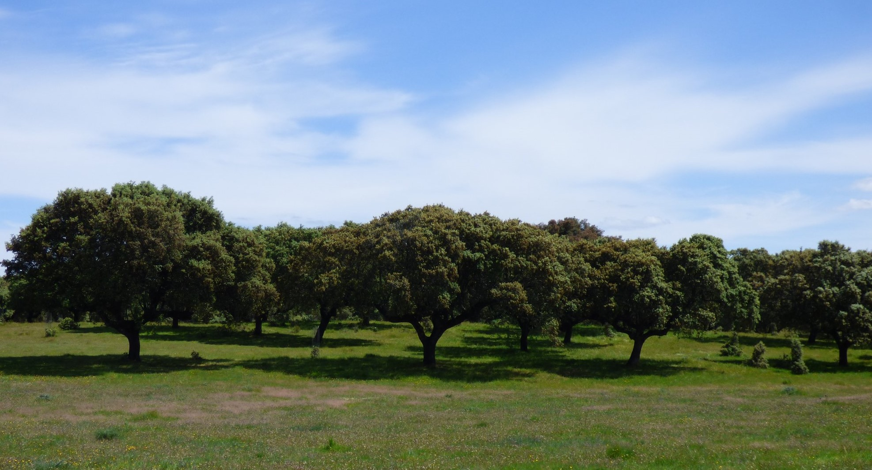
Extremadura AgriFood and Forestry Research Systems: Green and Climate Transition Plans in agriculture and in agroforestry systems
Eriaff Annual Conference, Bolzano, May, 22-24, 2023
Carmen González Director of the Centre for Scientific and Technological Research of Extremadura (CICYTEX)

Slide 2
Scenario
Extremadura region:
1.1 million habitants
Area 41,634 Km²
GDP 19€ billion
Barcelona
Oporto :
Lisbon:
Badajoz
Madrid
Sines
Seville
Huelva
Algeciras

Slide 3
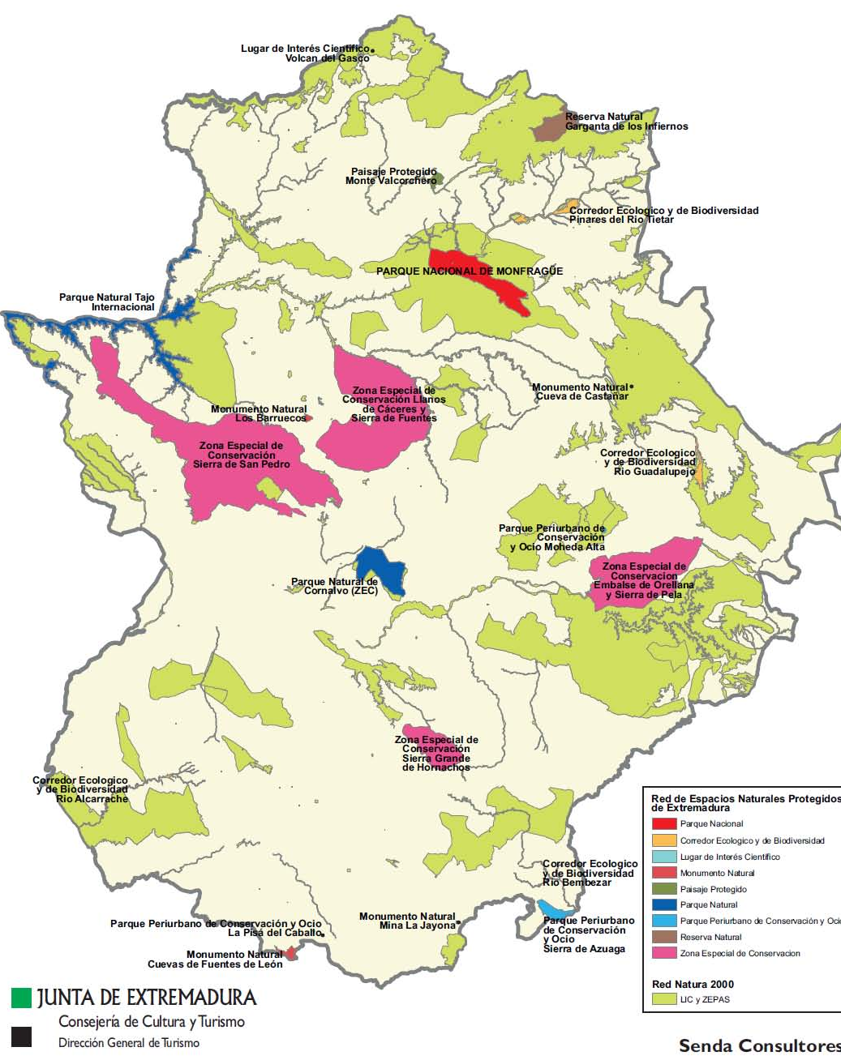
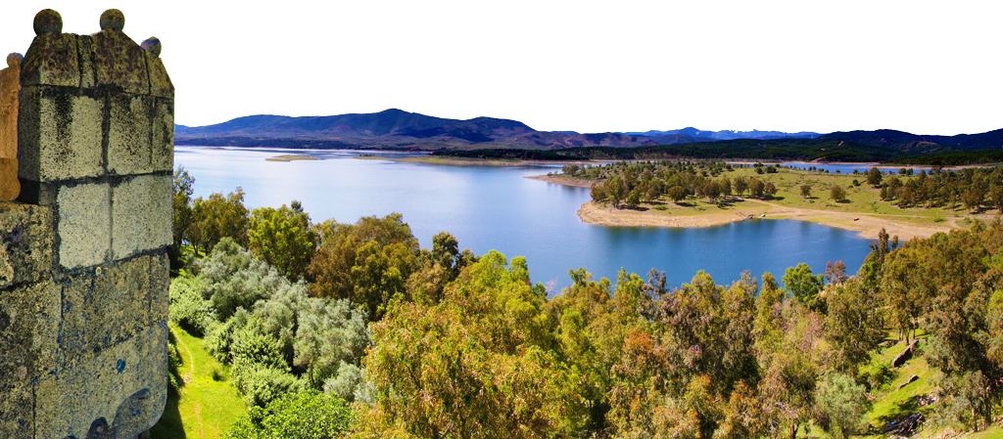
Natural resources and heritage
30% territory nature reserves and protected areas
25% water reservoir of Spain (14.000 Hm3) and 275.000 ha of irrigated agriculture
Energy surplus Extremadura generates 9.7% of the electricity and only consumes 1.7%
Leader in solar energy production
Low level of pollution, Rural and Urban
3 UNESCO Heritage of humanity locations
That doubles!!
Excellent high way connections
Badajoz Airport. Daily flight connection.
Madrid and Barcelona.

Slide 4
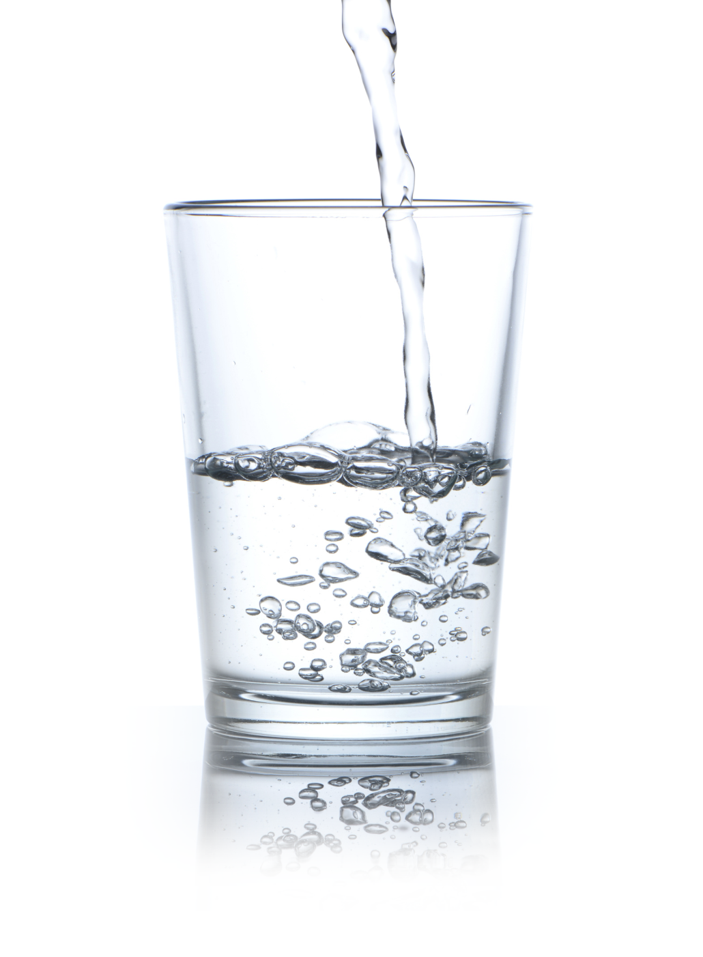
Efficient Management of Natural Hydrological Resources
Efficient management of fresh water and natural resources
Agriculture, intensive agriculture and sustainable hydroenergetic efficiency
Integration among productive agricultural and farming systems and natural ecosystems
Sustainable rural and urban developments
Genetic heritage, technology, biotechnology, information avant-garde systems in efficient management of natural hydrological resources

Slide 5
Green-economy in Extremadura
Business Bio-Specialization
62% of Extremaduras´s productive sector belongs to Agri-Food Sector
Food exports account for 56.3% of Extremadura total exports, compared to 15.7% of Spain
Scientific and technological Bio-specialization; our scientific production
70% of our scientific production is oriented to Chemistry, Biochemistry, Biotechnology or Ecodesign, and other sectors, all related to Bio-specialization

Slide 6
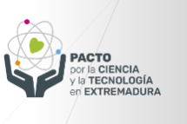
Green-economy in Extremadura
Extremadura is strongly committed to sustainable development and green growth, with a number of policies in place to promote a knowledge-based economic model that respects the environment and preserves its valuable natural heritage, betting on the agro-food sector and the sustainable management of natural resources as pillars of this model.
Regional Rural Development Plan
Regional Bioenergy Plan
Notes:
t is worth mentioning: the Smart Specialisation Strategy (RIS3), the VI Regional Research Development and Innovation Plan, the Extremadura 2030 Strategy, the Regional Bioenergy Plan and the Regional Rural Development Plan, among others.

Slide 7
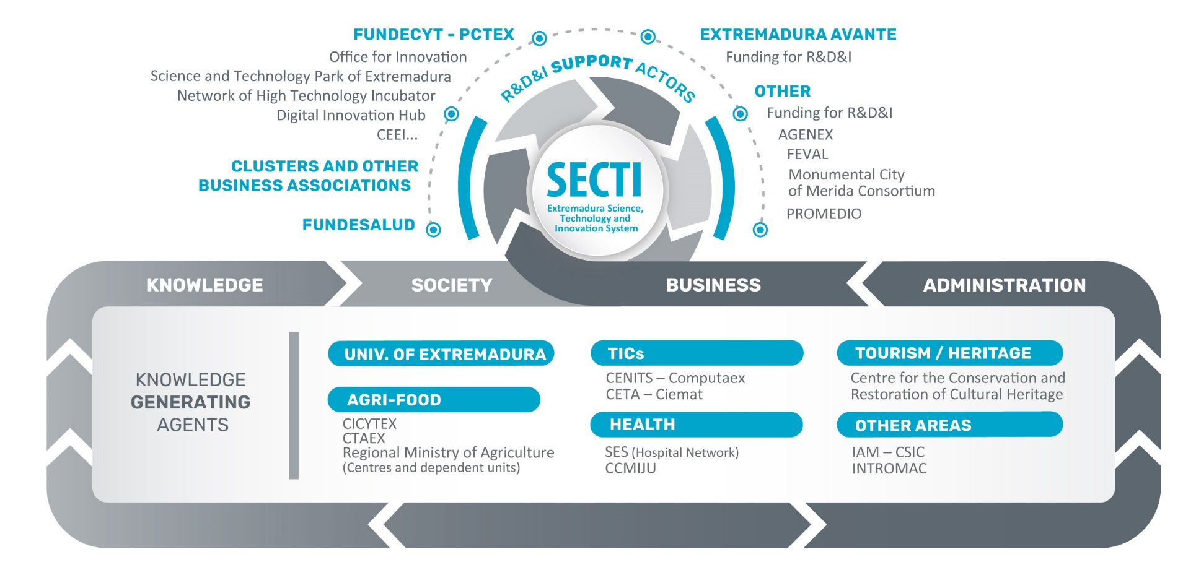
Extremadura Science, Technology and Innovation System (SECTI)
We have the tools, institutions and assets to develop our expertise

Slide 8
University of Extremadura
University Research Institutes
Indehesa: basic and applied research in the field of operation, management, valorization and conservation of multiple-use agroforestry systems and especially the Dehesa due to its relevance for scientific knowledge and social welfare, as the most extensive agroforestry system in Europe
Inura: improvement of the quality of agricultural products, acting from the use of natural resources, processing, conservation and/or commercial life to the production of high quality, safe and environmentally friendly agri-food products.
Iprocar: promote scientific and technical research on the quality of meat and meat products.

Slide 9
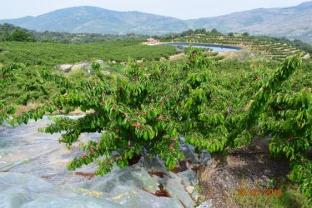
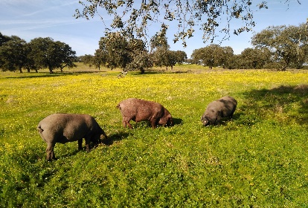
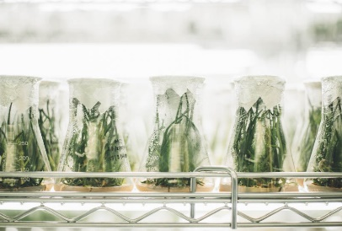
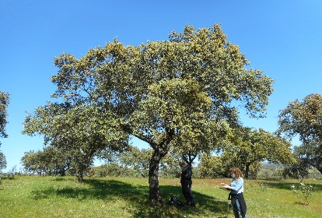
Centre for Scientific and Technological Research of Extremadura (CICYTEX)
Some strategic research and innovation lines:
Agriculture: adaptation and mitigation of agriculture in climate change, biodiversity of agricultural systems, efficiency in the use of inputs (water, fertilizers, etc.), adaptation of production to market demands,…
Animal production: production, management and genetic improvement of native breeds in extensive farming (dehesa ecosystem),…
Food: new technological processes for food transformation, storage, processing and packaging, development of healthier foods and use of bioactive and functional ingredients, enhancing the quality and increasing the shelf life of traditional foods to improve their competitiveness and valorization of agri-food by-products and waste.
Mediterranean Forest Systems: silviculture and applied ecology of forest systems, diseases and pests, improvement of forest resource utilization and integrated management of the pasture. Sustainability and adaptation to climate change in dehesas.
Cross-cutting research lines: use and development of cutting-edge digital technologies

Slide 10
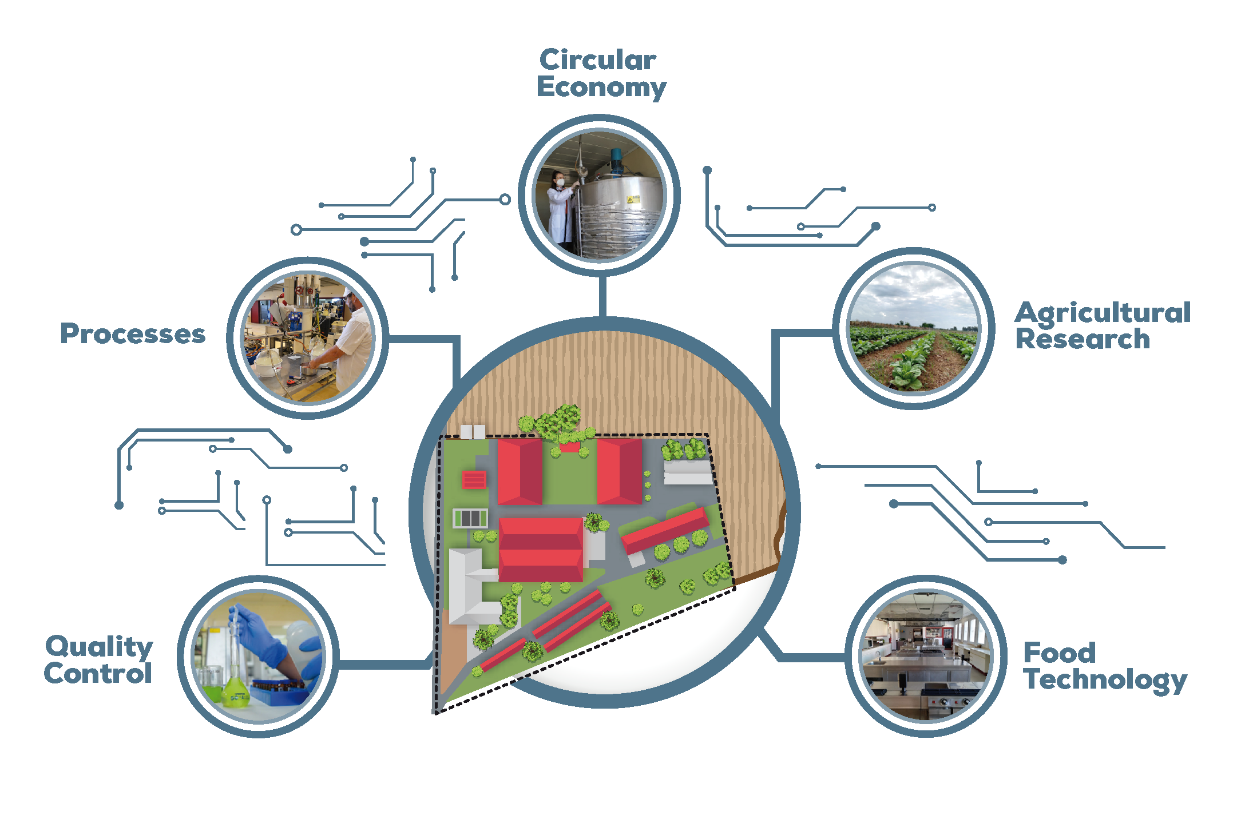
National Agri-Food Technology Center (CTAEX)

Slide 11
Extremadura RIS3
A strategy to move towards a green transition and a digital transformation.
Extremadura RIS3 has been designed in connection with existing policies and strategies at international, national and regional level, which aims to move towards a green transition and a digital transformation capable of generating value and sustainably exploiting our resources and capacities, making Extremadura an attractive destination for investment and talent.
A roadmap to make Extremadura an exporting region of own-brand products and services with high added value.
Notes:
t is worth mentioning: the Smart Specialisation Strategy (RIS3), the VI Regional Research Development and Innovation Plan, the Extremadura 2030 Strategy, the Regional Bioenergy Plan and the Regional Rural Development Plan, among others.

Slide 12
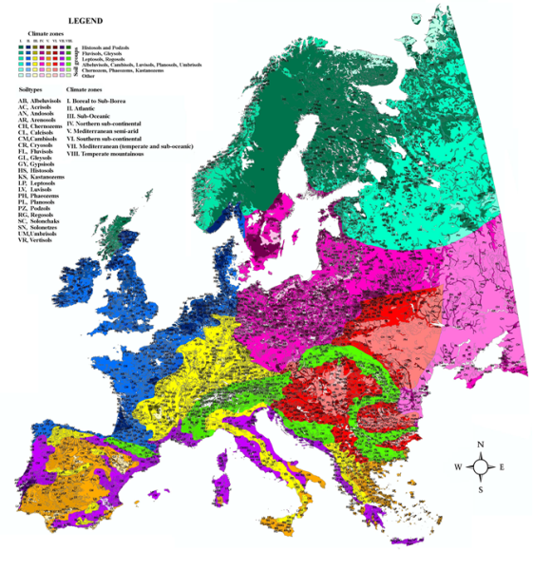
Pedoclimatic zones
Controlled deficit irrigation techniques for crop resilience to climate change
Csa Mediterraneo typical
Bsk Mediterranean continental steppe
Two seasons:
-Average temperature higher than 22ºC.
-Cyclical droughts.
-Heat waves.
-Humid and rainy season.
EXTREMADURA

Slide 13
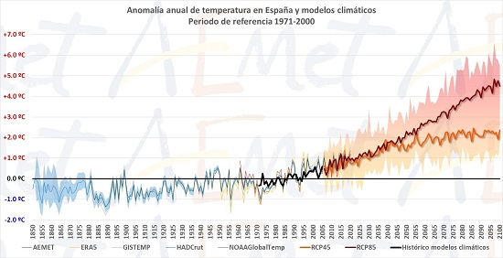
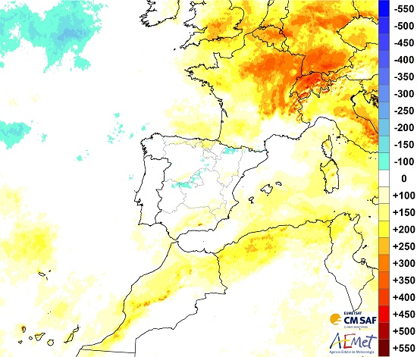
Controlled deficit irrigation techniques for crop resilience to climate change
CLIMATIC CHANGE

Slide 14
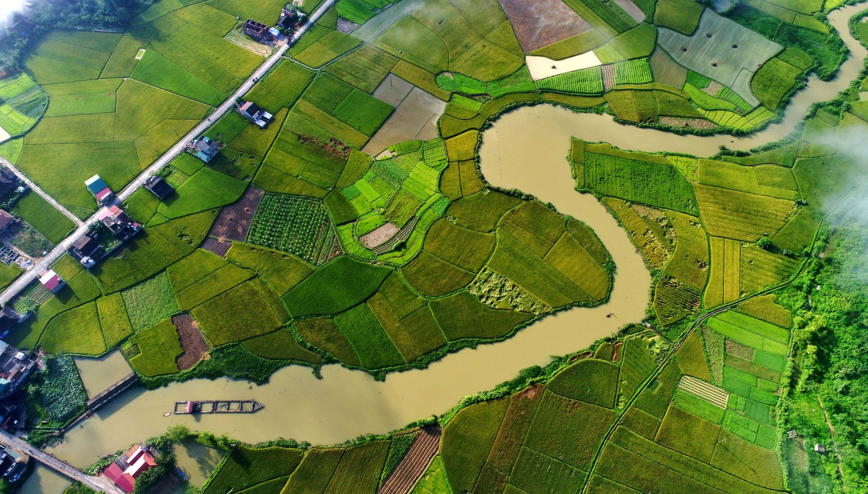
New scenario:
Changes in water demand:
More frequent and larger heat waves
Increased ETo (mainly summer crops).
Water uses:
Increased demand in other sectors (population, industry, tourism...)
Increase in irrigated areas

Slide 15
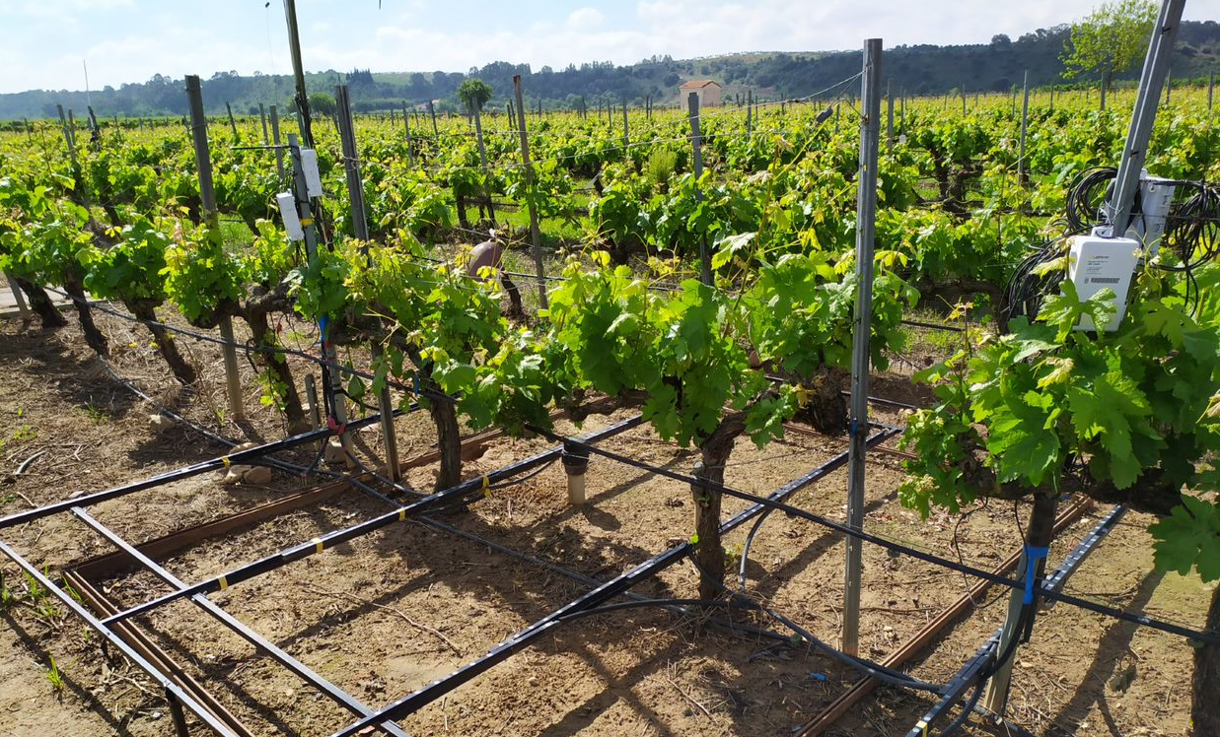
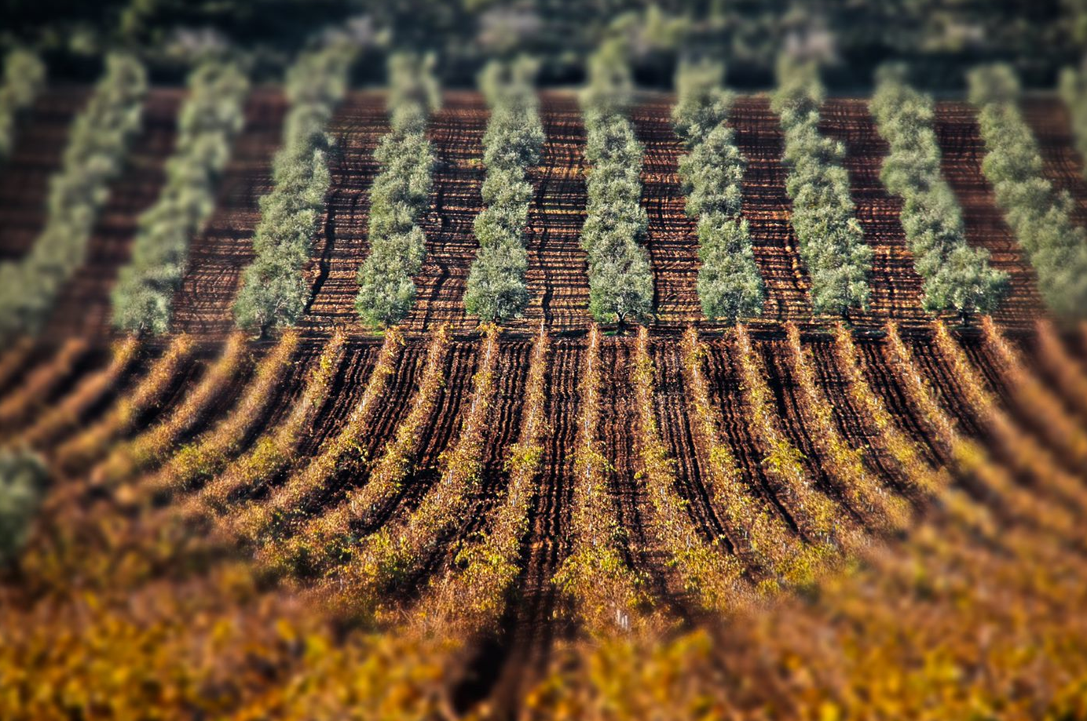
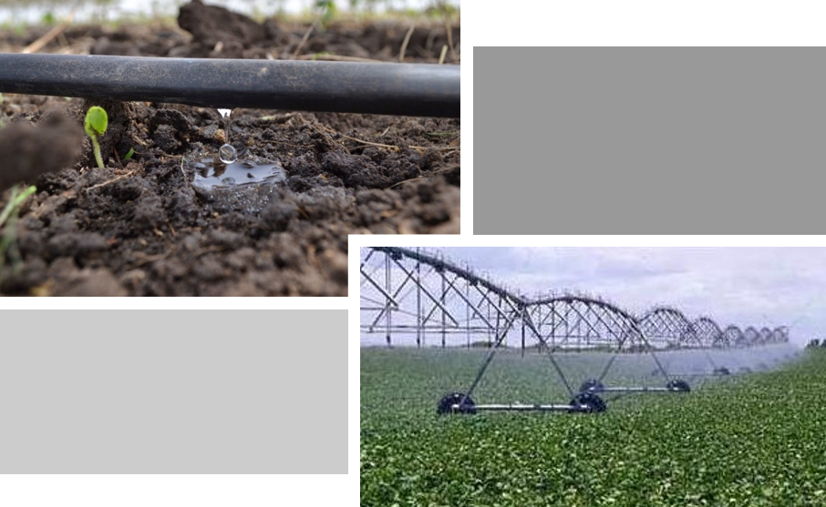
Controlled deficit irrigation techniques for crop resilience to climate change
Working lines of the research group:
ADAPTATION TO CLIMATE CHANGE
Export of technology and knowledge related to the agricultural sector to producers
Strategies to combat heat waves
Design of resilient cropping systems. Increasing biodiversity. Crop rotations. Establishment of new crops.
CLIMATE CHANGE MITIGATION
Role of irrigation in climate change. Carbon sinks
Life cycle analysis. Energy/water balances to analyze initial situation and suggest reductions CAP
To cover crop water
requirements
Areas of expertise:
Crop Ecophysiology
Irrigation
Fertilization
Agronomy
Crop protection
Crops:
Vegetables
Fruit
Olive
Vineyard
Oaks and chestnut
Adoption of deficit irrigation strategies​

Slide 16
More strategic sectoral projects in agriculture, food and forestry
MIPEX. Integrated management of diseases and weeds for plant protection in Extremadura.
CERAVEX. Agronomic suitability of new cherry varieties and viability of hazelnut cultivation in northern Extremadura.
AGROS2022. Challenges of irrigated agriculture in Extremadura.
SINERGEX. Establishing synergies to address the sustainable management, productivity and adaptation to climate change of cork oak forests and dehesas in Extremadura.
GREEN HOPE. Agro-livestock strategies for the economic and environmental sustainability of dry land farming in Extremadura.

Slide 17
More strategic sectoral projects in agriculture, food and forestry
IMPROTEC. Implementation and optimisation of technological processes to improve the competitiveness of agri-food products from Extremadura.
CRUCIFOOD. Revalorisation of by-products and co-products from the brassica vegetable processing industry for application as food additives and/or in active packaging.
MEAT. Strategy for the development of a comprehensive plan for the study, dissemination and application of R&D&I in the meat sector in Extremadura.
COPLAGAN. Improvement of livestock production in extensive systems through the use of natural food supplements.
ALTEBIOTIC. Alternatives to the use of antibiotics in different production phases of extensive livestock species, as a preventive against bacterial and parasitic diseases: economic and health impact on the welfare of these livestock farms

Slide 18
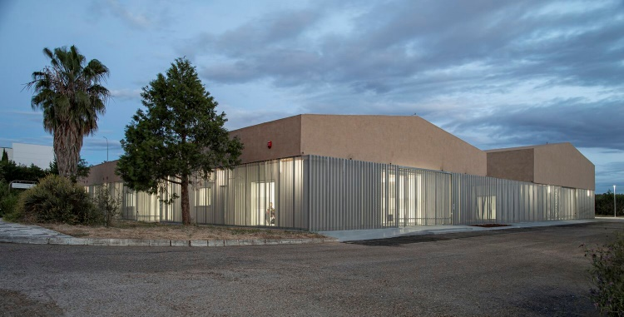
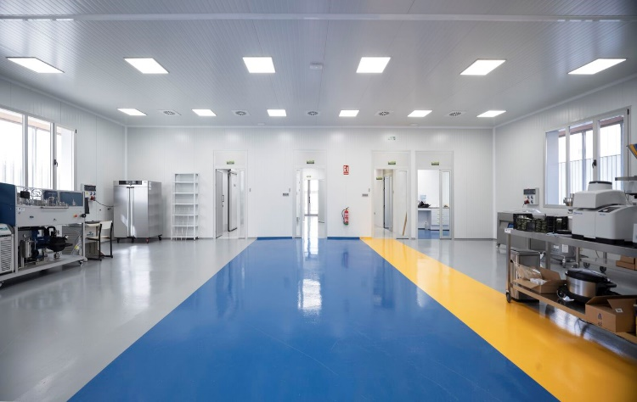
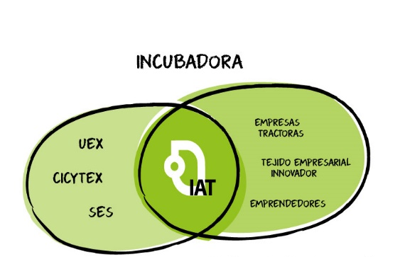
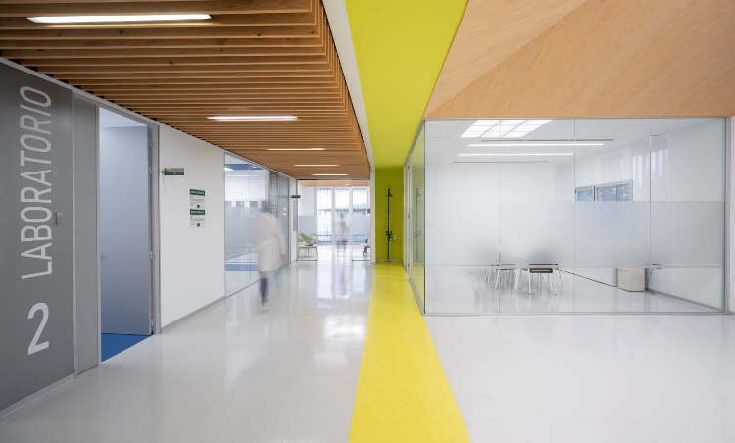
High Technology incubator in Bioeconmy and Circular Economy
The High Technology Incubator, specialising in Bioeconomy and Circular Economy, has been conceived to support technology-based business projects aimed at obtaining new products/processes with high added value through purification techniques and biotechnological processes, based on the region's natural resources and the by-products and waste from the agri-food industry.
Infrastructures, basic and technological equipment
Main building equipped with incubation spaces, R&D&I facilities (individual and common laboratories), meeting rooms and central offices of the incubator. 512.5 m2 of useful surface area.
Pre-industrial pilot plant designed to test any type of process related to the food industry or first transformations, in order to ensure its adaptability to different processes and to avoid cross-contamination in the event of environmentally incompatible processes. 544m2 of usable area.
ECOSISTEMA DE ALIANZAS
Offering services and infrastructures to accelerate the process of responding to the challenges and opportunities arising from the market or from the results of scientific and technological research.

Slide 19
Complementary Agri-Food Plan AGROALNEXT
R+D+I program of the national Ministry of Science and Innovation: 49.2 million €
Objective: to promote the double transformation, digital and sustainable, of the agri-food sector, to increase its competitiveness, achieving the climate and environmental objectives set out in the Green Deal, while guaranteeing the supply of healthy, safe, sustainable and accessible food to the population, as pursued by the EU Farm to Fork Strategy
Navarra, Aragón, Comunitat Valenciana, Extremadura, La Rioja, Asturias y Murcia
Lines of action:
Sustainable primary production. ecological transition
Guarantee of supply of healthy, safe, sustainable and accessible food in the field of the agri-food industry
Digital transition of the agri-food sector
Circular economy
Innovation and transfer
Reinforcement of infrastructures and resources to improve the competitiveness of R+D+I entities and promote transfer to the market
Coordination, dissemination and training
The specific objectives of the program are:
Investigate and generate new highly applicable knowledge and opportunities for innovation.
Connect and train agents
Acquire talent, equipment and facilities and promote collaboration between research organizations for excellent and efficient R&D and innovation, reaching the market.
Promote cooperation and the development of key synergies in innovation, internationalization and sustainable development.

Slide 20
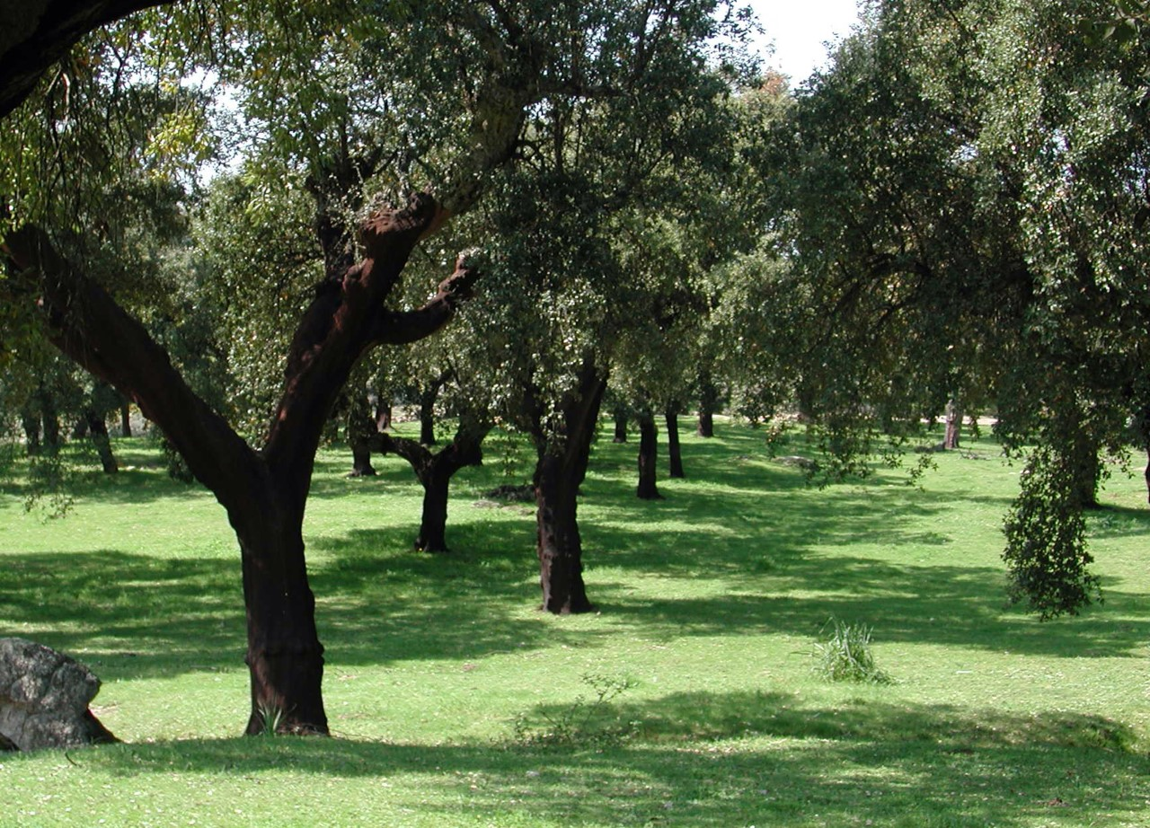
Thank you for your attention!

